Slide 1
Designing and developing a novel culinary dish incorporating colour changing ingredients and 4D technology
Róisín Burke, Rachel Cooney, Ben Fitzgerald, Charlotte Lambe, Rosie Muldowney and Pierce Prendergast.
School of Culinary Arts and Food Technology, TU Dublin, Grangegorman, Dublin 7, Ireland.

Slide 2
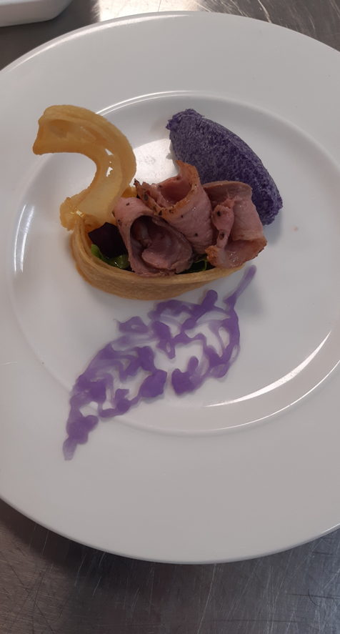
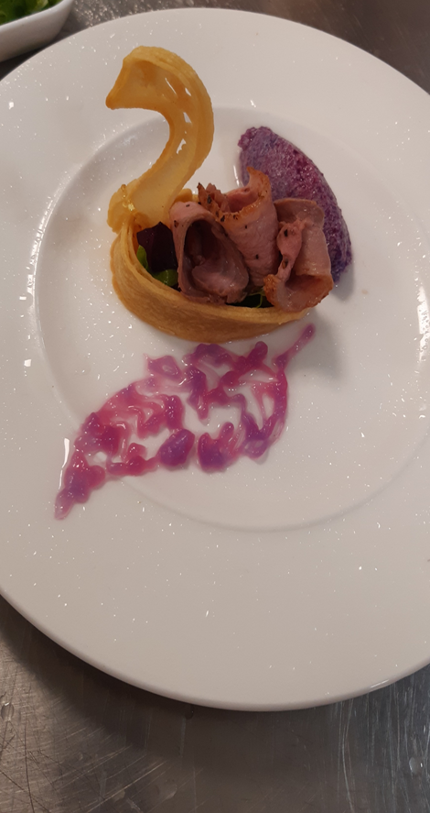

Aim
To design and develop an innovative dish for diners

Slide 3
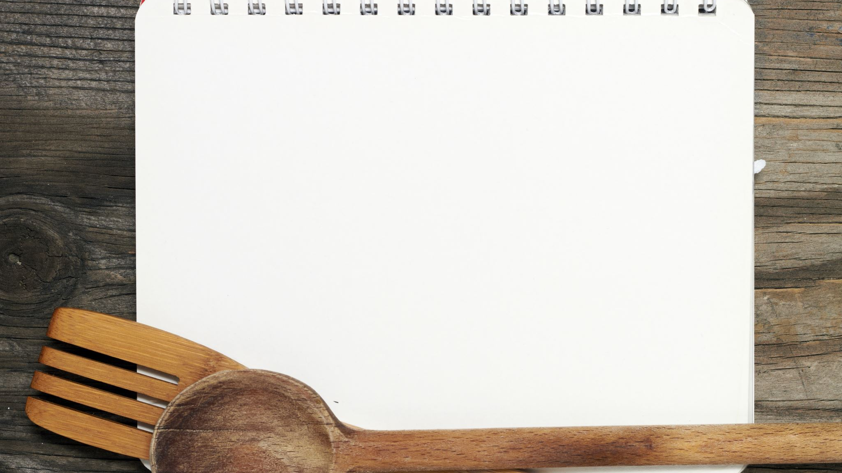
Recipes
Pasta for 3D printing duck: 7 g of oil and 40 g of water were weighed into a jug and the whole contents (45 g) of a packet of pasta dough powder was added (Procusini). The dough was mixed using a hand mixer at a low speed (< 3,000 rpm) for 3 min when a dough was formed. Then the dough was filled into a disposable piping bag and let rest at room temperature for 45 min, so the water can penetrate the starch granules by capillary action (This, 2007).

Slide 4
Recipes
Salad
Ingredients:
1 handful of Rocket; 30 mls of Extra virgin olive oil
1 tbsp Red wine vinegar; 2 tsp Diion mustard
1 shallot diced
Method: Mix together and dress the rocket leaves
Pasta for 3D printing duck: 7 g of oil and 40 g of water were weighed into a jug and the whole contents (45 g) of the packet of pasta dough powder was added. The dough was mixed using a hand mixer at a low speed (< 3,000 rpm) for 3 min when a dough was formed. Then the dough was filled into a disposable piping bag and let rest at room temperature for 45 min, so the water can penetrate the starch granules by capillary action (This, 2007).

Slide 5
Recipes
Duck meat
Ingredients:
1 duck breast; salt and pepper to taste
Method:
Sear on hot pan, fat side down 12-15 mins. Flip for 1 minute. Place in oven at 200 ◦C for 6 minutes.

Slide 6
Recipes
Purple cabbage mousse (changes to red cabbage mousse when sprayed with vodka/lemon juice liquid).
Ingredients:
200g sliced purple cabbage; 200 ml fresh cream;105 ml stock;1 sliced shallot; 5g butter; 15g parmigiano
Method:
Melt butter in a pan. Cook the shallot for 5 minutes. Add purple cabbage, salt and pepper. Add stock, cook for 15 minutes. Blend in parmigiano and cream. Put in a siphon and leave in fridge before using.

Slide 7
Recipes
Herb flavoured vodka
75 ml vodka; 105 ml lemon juice (Newforge lemon juice); 3g herbs (rosemary and thyme)
5 ml lemon juice added after rotary evaporation.
Water bath: 40 ºC; Rotation speed: 120 rpm
Purple cabbage feather gel
92.5 ml purple cabbage water (from 1.85 litres to 500g of cabbage);12 grams of potato starch.
Method
Mix the potato starch and cabbage water on a stove in a pot until mixture reaches 56 ℃

Slide 8
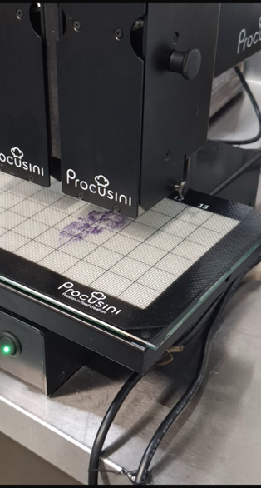
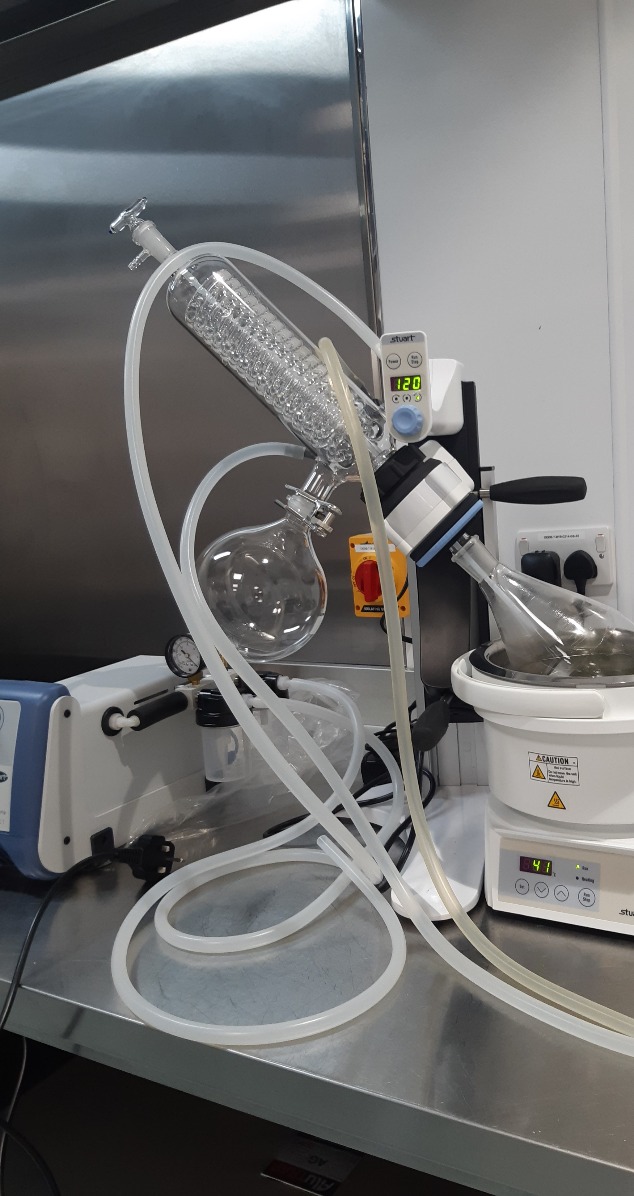
Specialized Equipment

Slide 9
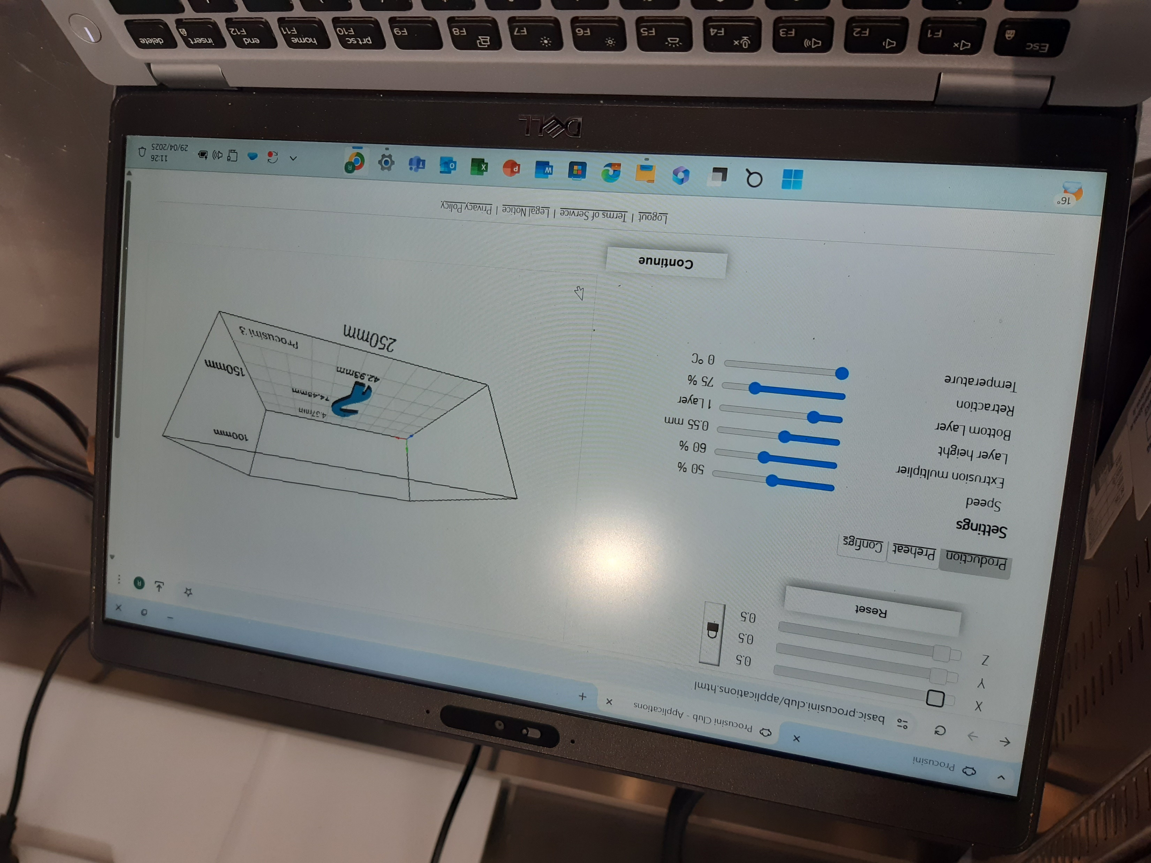
Measurements

Slide 10
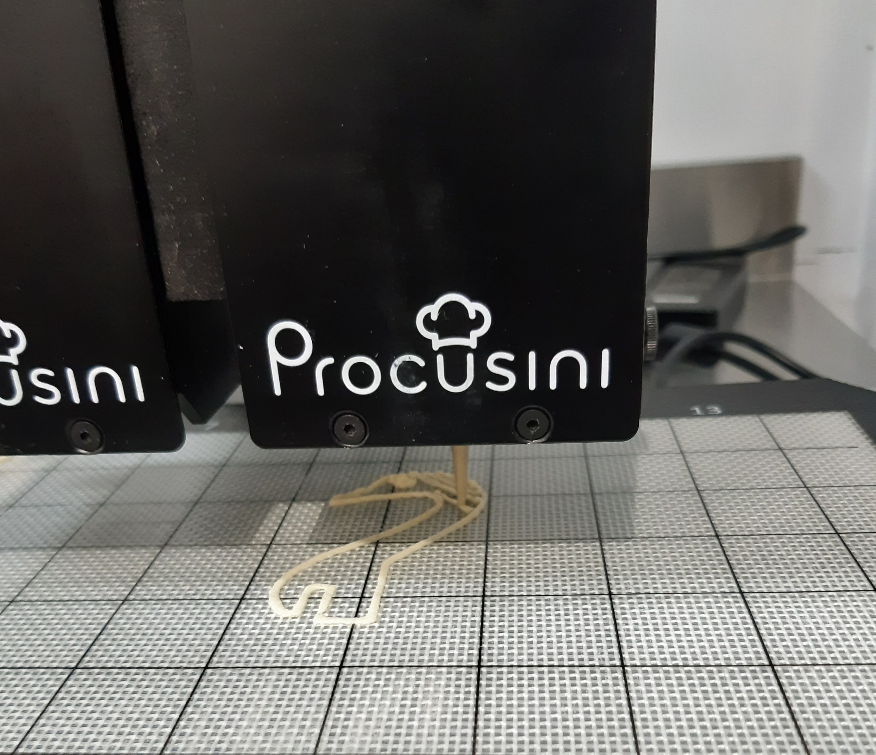
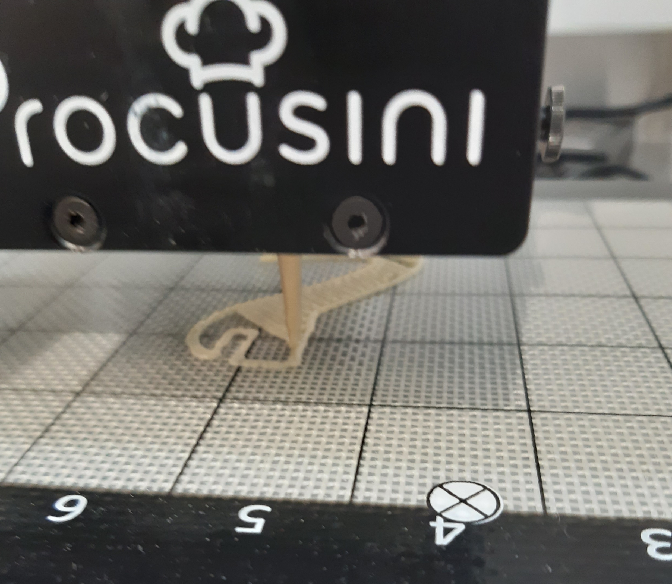
3D Printing of Duck PARTS

Slide 11
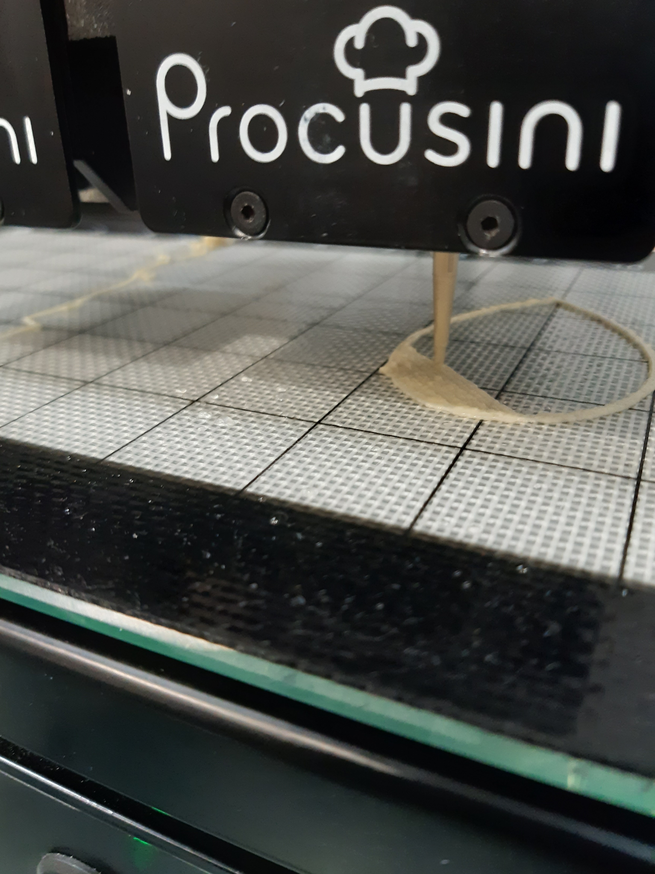
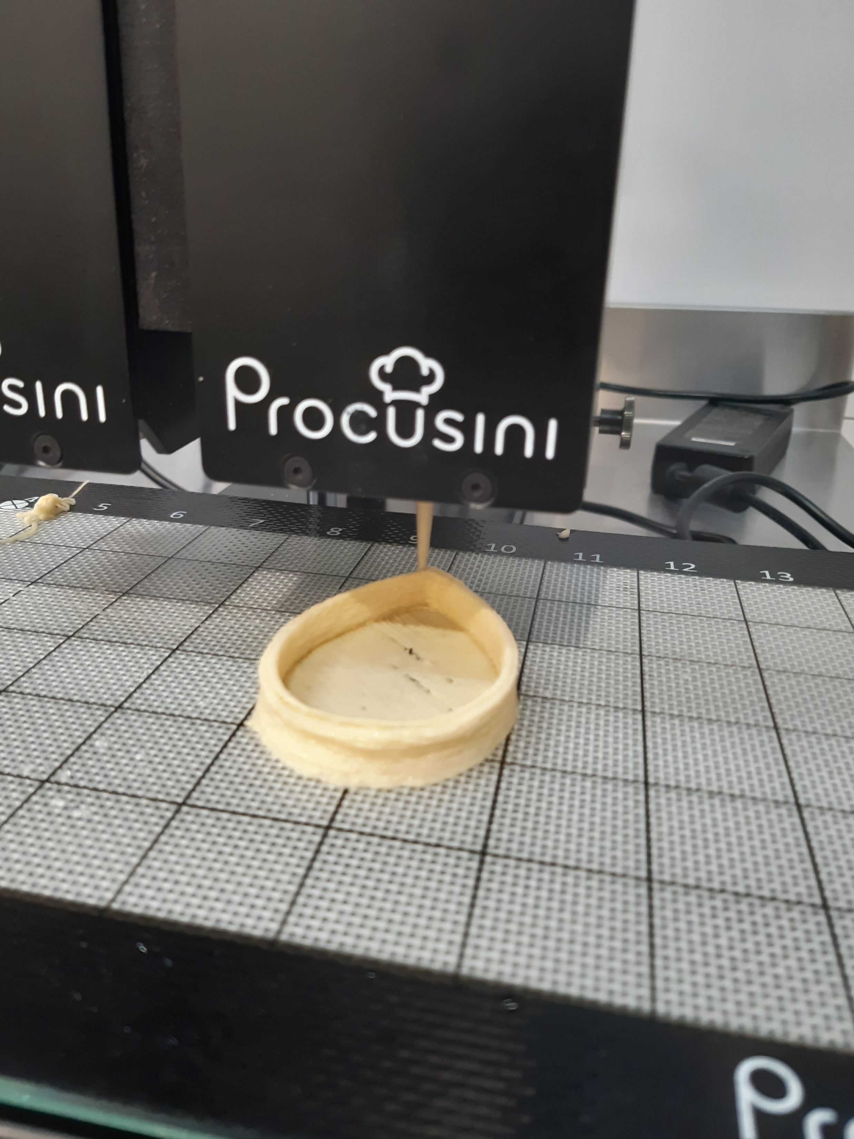
Duck Body

Slide 12
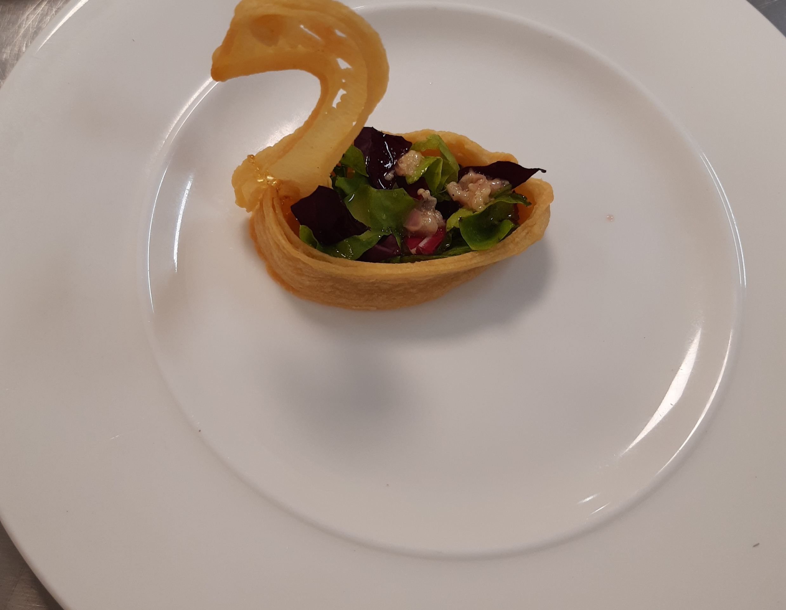
Assembling the 3D Printed Duck

Slide 13
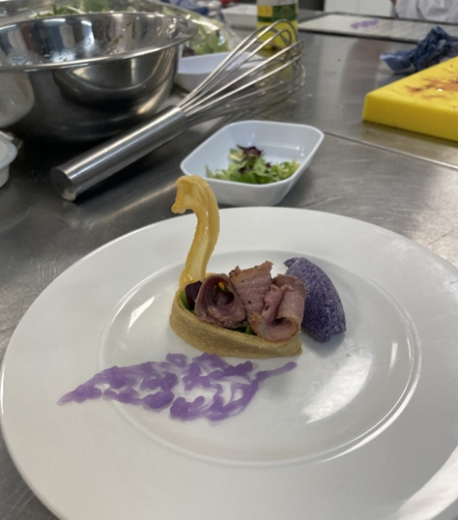
Adding the Duck Meat, MOUSSE, Salad AND 3D Printed PURPLE CABBAGE/ POTATO STARCH GEL FEATHER

Slide 14
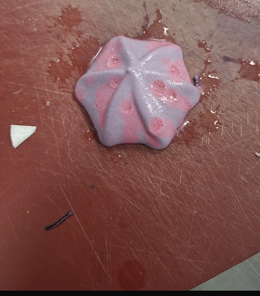
CABBAGE MOUSSE
The cabbage mousse (not 3D printed) was sprayed with the herb flavoured vodka and lemon juice liquid and a pink colour started to appear.

Slide 15
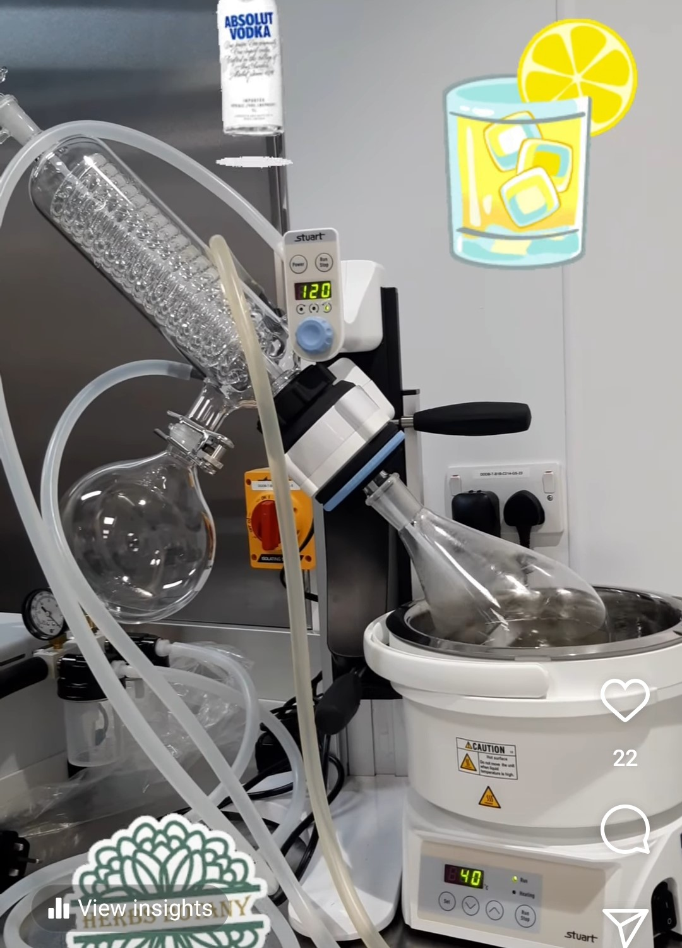
Herb flavoured vodka
Vodka with Rosemary and Thyme flavour compounds.
Lemon juice added afterwards
pH 3.00

Slide 16
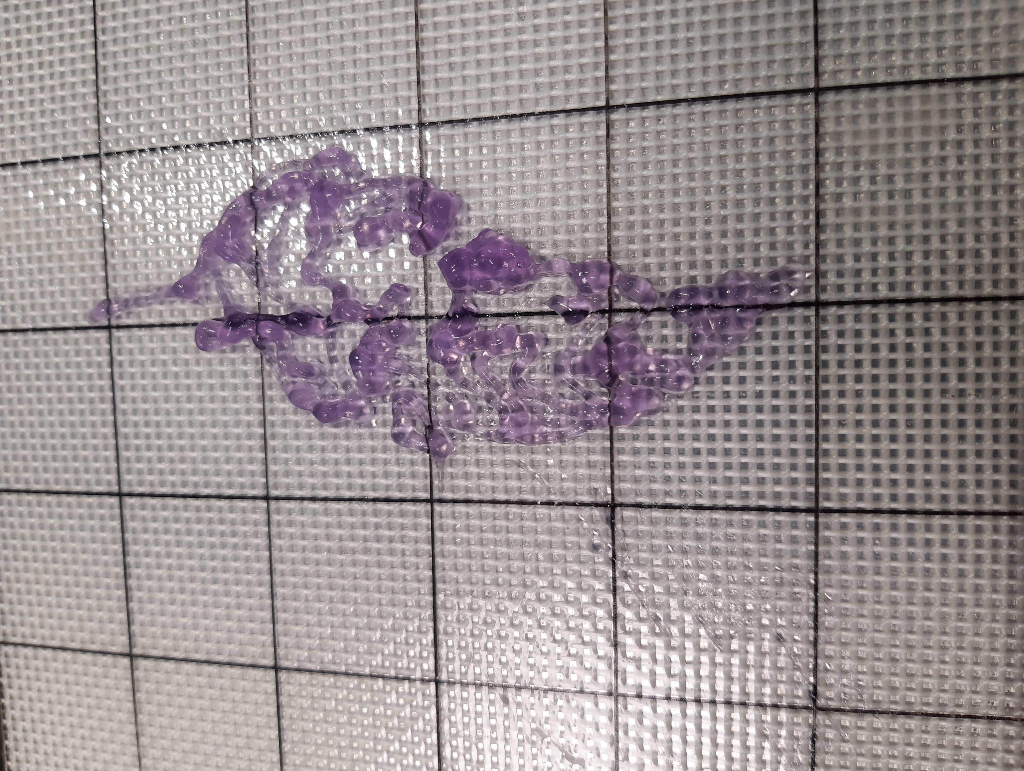
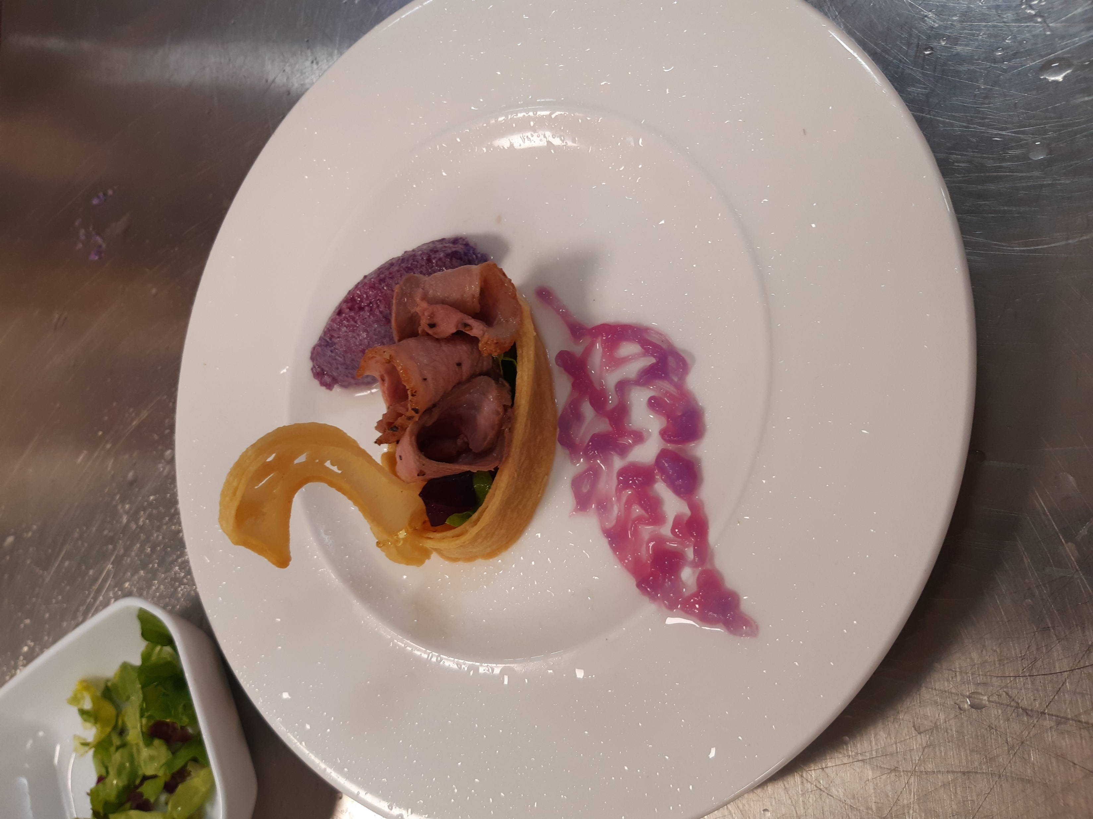
3D Printed PURPLE CABBAGE/POTATO STARCH GEL
Spray with VODKA/HERB/LEMON LIQUID
4D Printed RED CABBAGE/POTATO STARCH GEL stimulus-responsive material: CABBAGE POTATO GEL, a stimulus: pH (3.00), time: Colour changes within 45 seconds.
a value (redness) = 26.6
b value (blueness) = -23.9
a value = 34.4
b value = -9.2

Slide 17
Conclusion
An innovative dish was designed and developed which included 3D and 4D elements.

