Slide 1

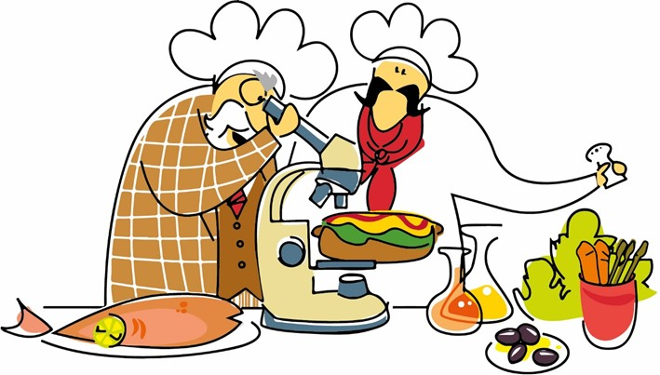
Personal views of some trends in food science
José Miguel Aguilera
Emeritus Honorary Professor, Pontificia Universidad Católica de Chile
Presented at AgroParisTech, June 12, 2023

Slide 2
TOPICS
Comments on the concepts of alimentation (food and nutrition) and health (e.g., “halthy foods”
The food matrix and nutrients
Designing food for the elderly population
Novel foods
Wild berries from Patagonia (Cape Horn)

Slide 3
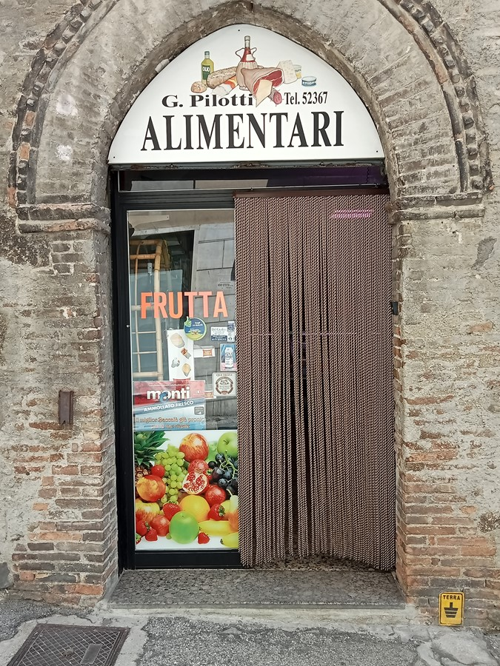
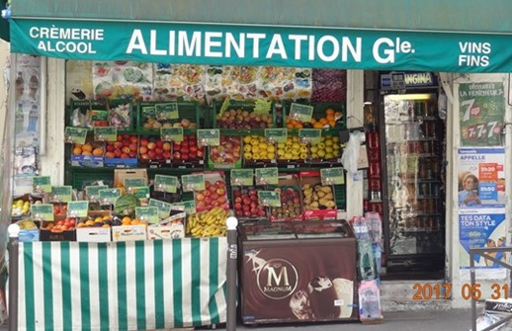
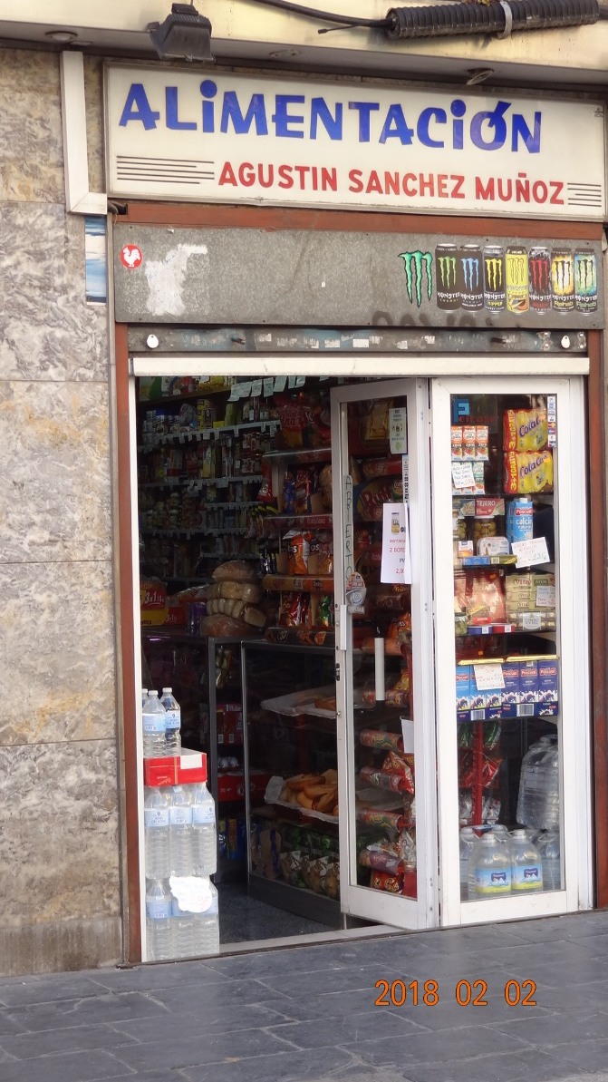

Slide 4
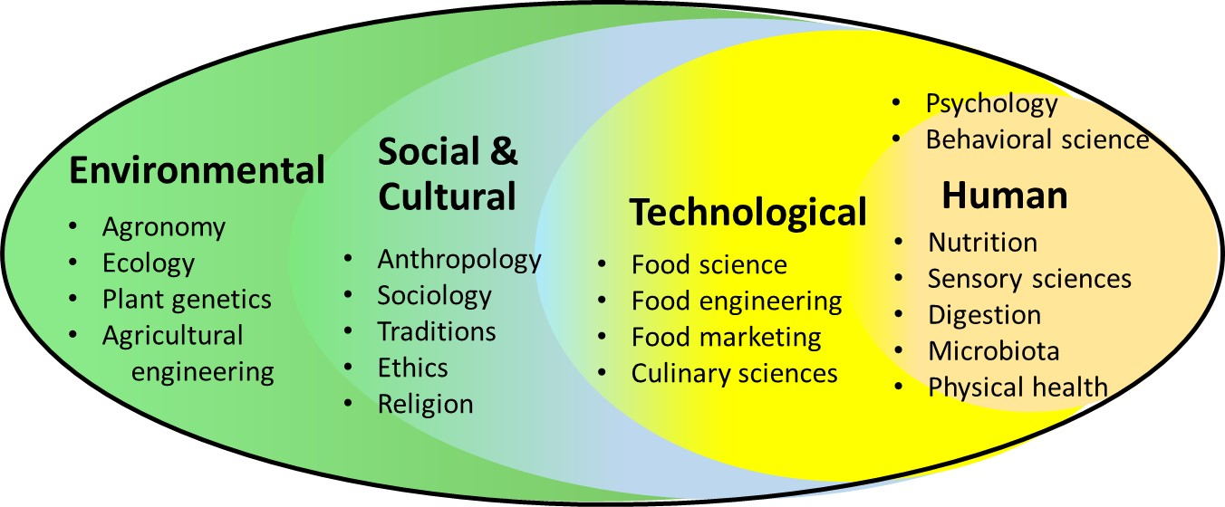
The scenario is not food and nutrition but alimentation …
ALIMENTATION

Slide 5

What is health?
The constitution of the World Health Organization of the United Nations (1947) defines health as:
“a state of complete physical, mental
and social well-being and not merely
the absence of disease or infirmity”

Slide 6
The Food-Matrix effect (FME)
Isolated
nutrient
Structured
matrix
Grinding
Extraction
Separations
Other
components
Aqueous
(solvent)
phase
Microregions
In the laboratory
(analytical methods)
Food and GIT
Aguilera, J.M. 2018. The food matrix: Implications in processing, nutrition and health. Crit. Rev. Food Sci. Nutr. 59(3):1-43.

Slide 7
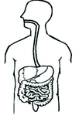
The interface with nutrition
Health and wellbeing
Nutrient
supplementation
Brain-gut- microbiota axis
GREAT
The brain-gut-microbiota axis
Role of the commensal gut microbiota in disease, obesity, brain function, behavior, etc.
Food, not nutrients, is the fundamental unit in nutrition – the food matrix & nutrient synergism
NOT SO GREAT
“Nutritionism”: the exaggerated connection between particular nutrients and bodily health
Role of exogenous bioactive compounds (e.g., antioxidants)? – the nutraceutical business
Unclear evidence from epidemiological/clinical studies and link w/chronic diseases & diet
Nutrients in
a food matrix
Matrix breakdown
during oral processing
Food microstructure
and digestion
Interactions/
synergisms
Nutrient
bioavailability
Microbiota/
microbiome

Slide 8
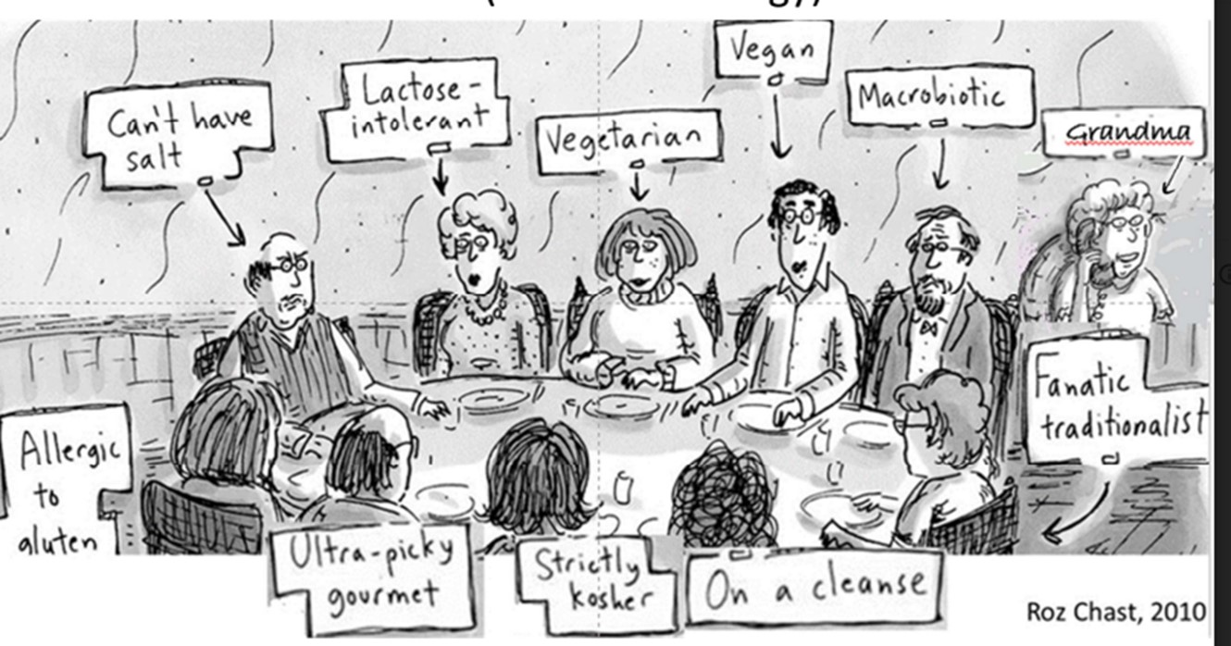
Particular alimentations (personalized foods)

Slide 9

Food and care for
the elderly
Age group (years) | Number
ITALY
70–74 | 3,301,000
75–79 | 2,753,000
80–84 | 2,258,000
85–89 | 1,435,000
90-94 | 532,000
95+ | 185,000
https://www.nestle.in/nhw/healthy-living/seniors/nutrition-challenges-for-elders

Slide 10

Brain signaling
Simulation and modelling
Oral
processing
Swallowing
Digestion
Microbiome
BODY
Dysphagia
Choking
Sarcopenia
Malnutrition
Dysbiosis
Mastication
Sensorial
Nutrient bioavailability
Knowledge-
based toolbox
Multi-scale
matrix design
Formulation/
processing
technologies
FOOD
SOCIAL
Interventions and clinical studies; commercial products
Aguilera, J.M., Covacevich, L. 2023. Designing foods for an increasingly elderly population: Curr. Opinion Food Sci.

Slide 11
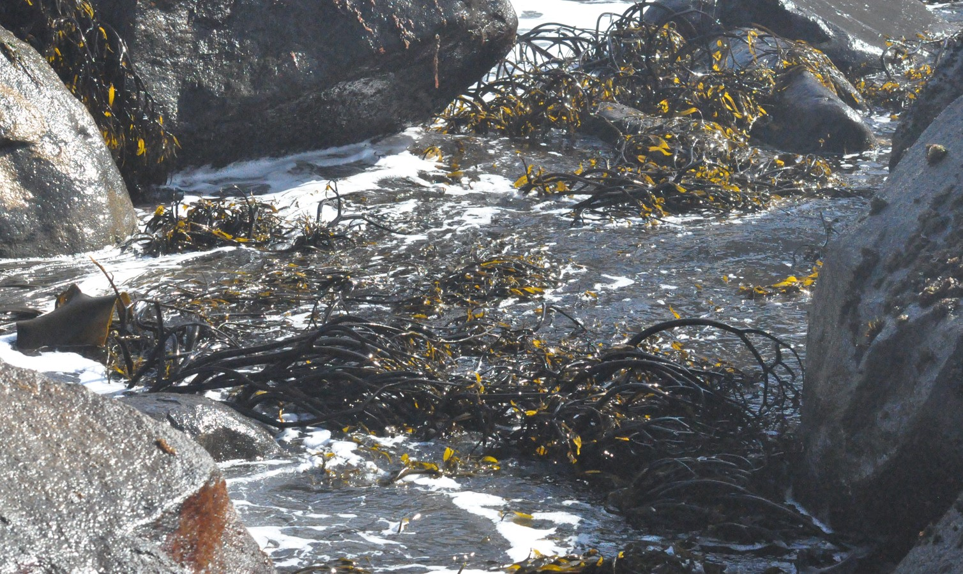
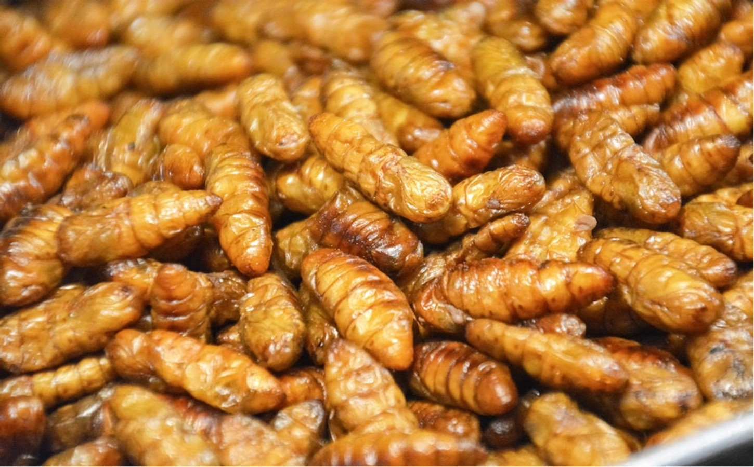

Seaweeds
Insects
NOVEL FOOD SOURCES
Use of underutilized resources
Low environmental impact
Tuned to local habits
Wild berries
Ancestral grains

Slide 12
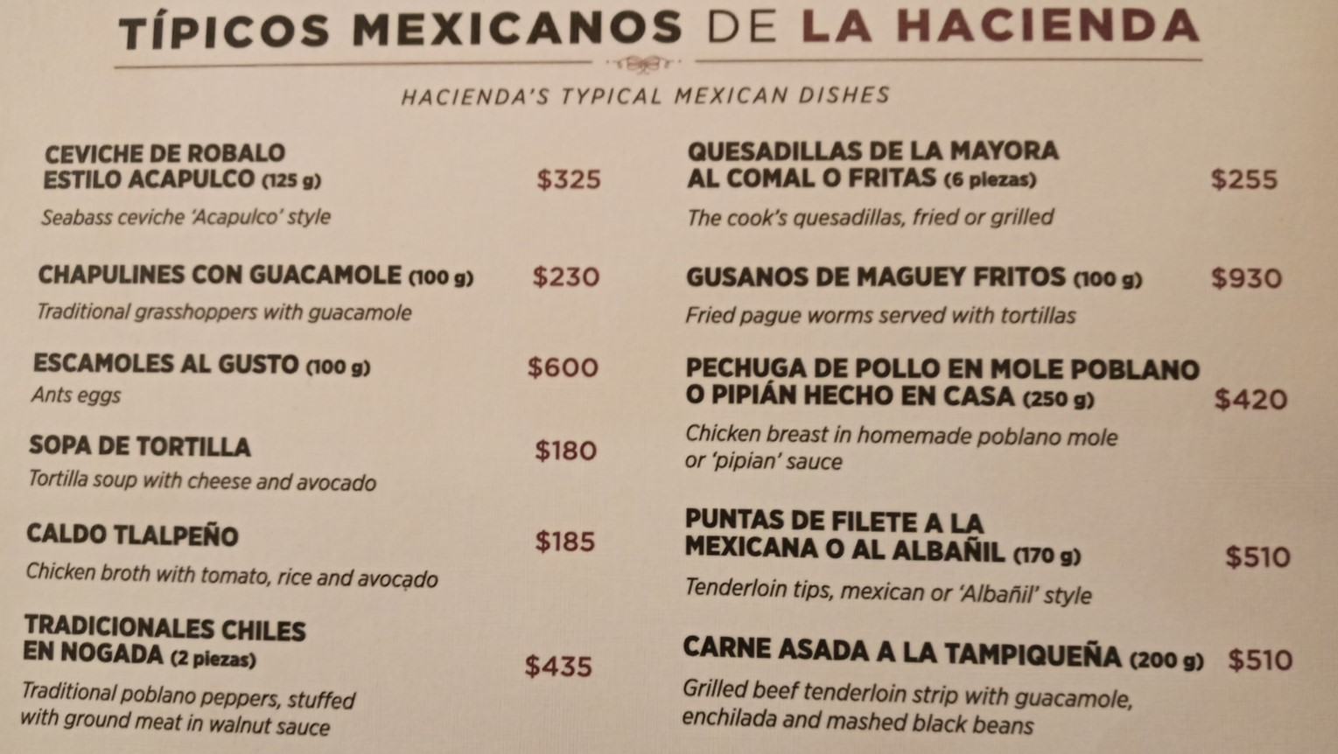

Slide 13
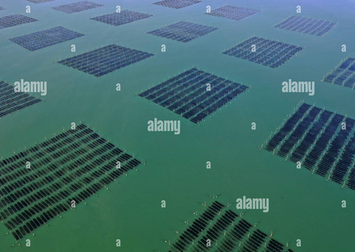
Seaweeds (macroalgae) as food
The most efficient converters of food biomass
No need for arable land or fresh water
95% of processed seaweed is cultivated
In Orient: up to 10% of the diet
Sources of fiber, micronutrients, bioactives and flavor (umami)
Great interest for seaweed gastronomy among chefs
Figueroa, V., Farfán, M. & Aguilera, J.M. 2021. Seaweeds as novel foods and source of culinary flavors. Food Rev. Int.

Slide 14

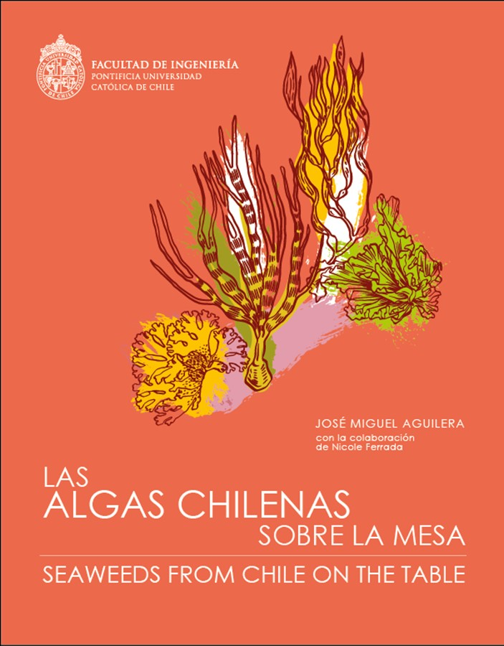




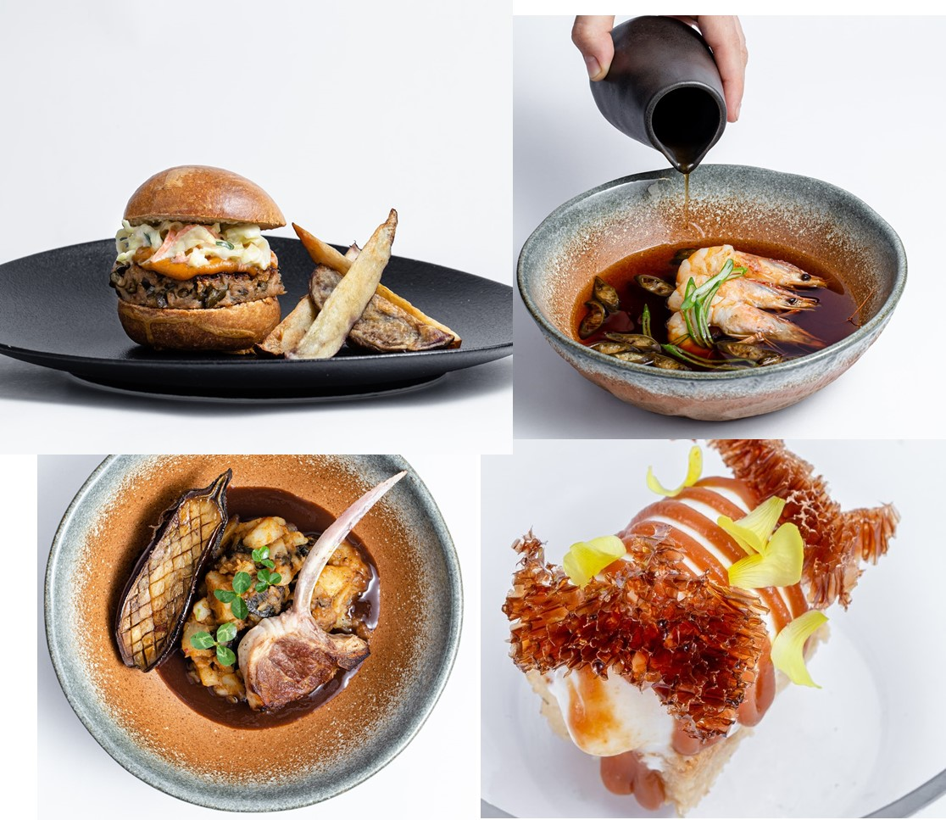
Output and dissemination
www.gastronomicengineering.com

Slide 15
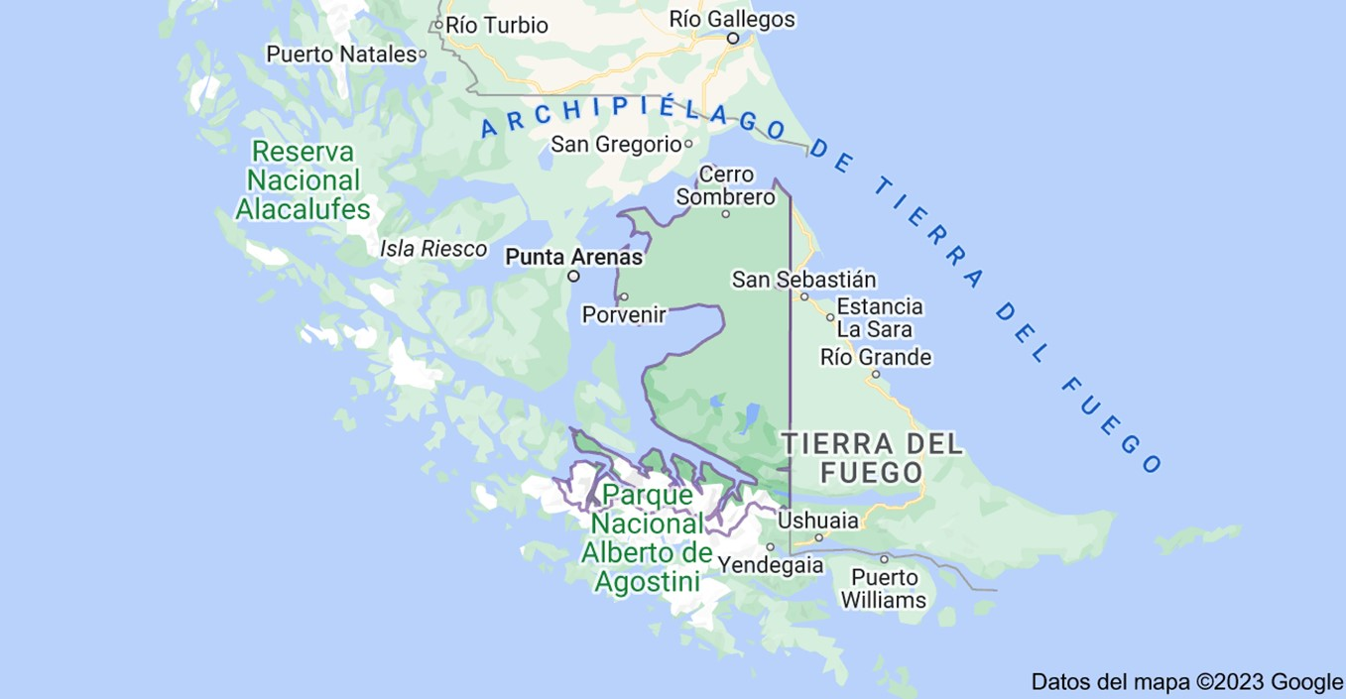
The subantarctic region (Patagonia, Cape Horn)
Cape Horn

Slide 16
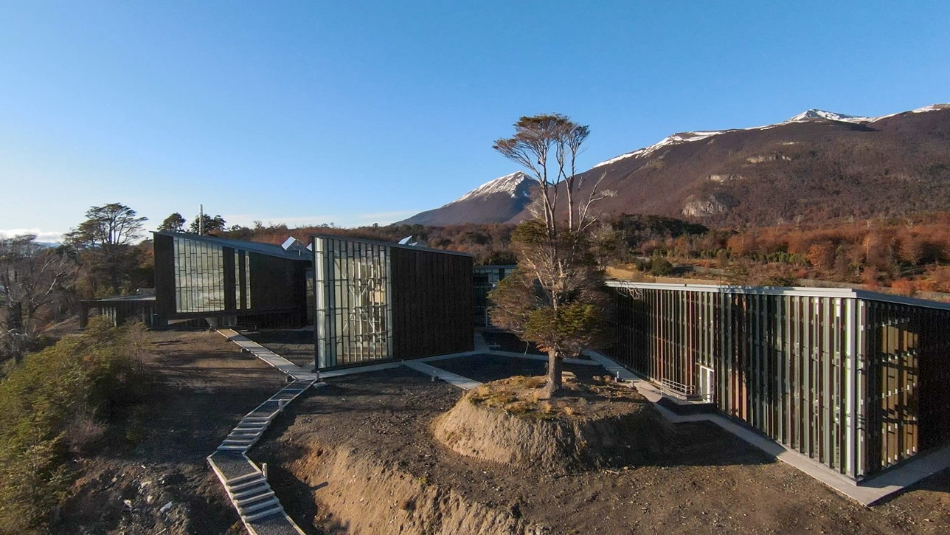
Cape Horn International Center (CHIC) Puerto Williams Chile

Slide 17
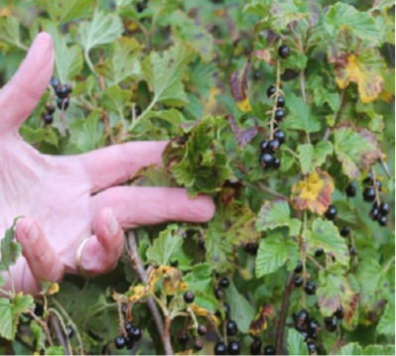
Wild berries
Consumption of berries has increased exponentially in last decade (e.g., blueberries)
“Natural and healthy”, tasty and convenient
Local berries: many traditional products (medicine) and biocultural impact
90% of wild berries go unpicked
Great sources of fiber and bioactives (antioxidants)
Nutraceutical business
Zarzaparrilla (Ribes magellanicum)
Aguilera, J.M. & Toledo, T. 2022. Wild berries and related wild small fruits as traditional healthy foods, Crit. Rev. Food Sci. Nutr.

Slide 18
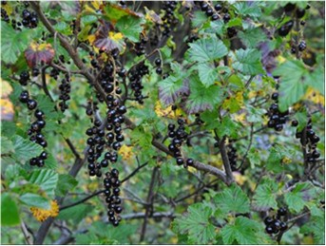
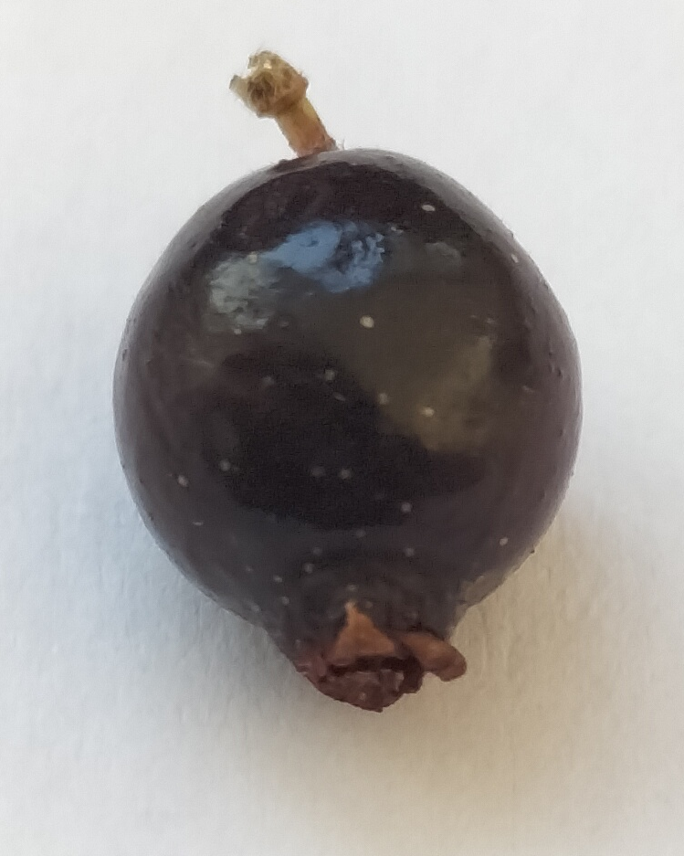
Ribes magellanicum - Zarzaparrilla

Slide 19
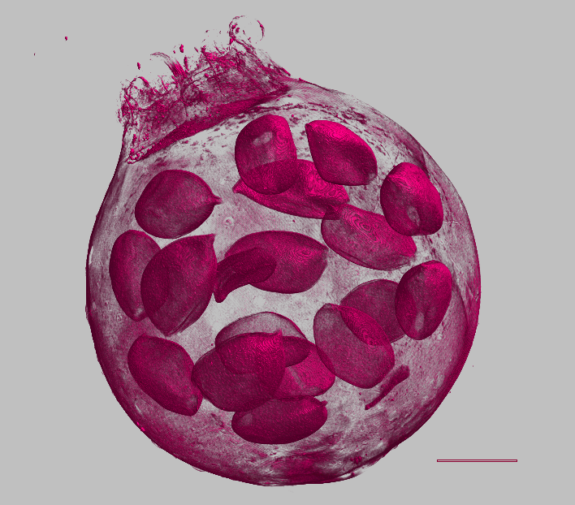
X-ray CT of Ribes magellanicum
0.5 mm

Slide 20
Thank you
José Miguel Aguilera
jmaguile@ing.puc.cl

Slide 21
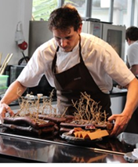
Gastronomic engineering (GE)
2006. Visit of a young chef (Rodolfo Guzmán, Boragó)
“GE is applying the fundamentals, methods and tools of food engineering for the advancement of culinary practices, and the design and elaboration of novel gastronomic products”
Looking and studying the engineering and physics inside foods and their relation to culinary
Engineering of foods that are readily eaten (Y. Roos)
GE unit: space of co-creation combining the rigor of food technologists and the creativity of chefs (2014)
Aguilera, J.M. 2017. The emergence of gastronomic engineering. Innov. Food Sci. Emerg Technol. 41:277–283.

Slide 22
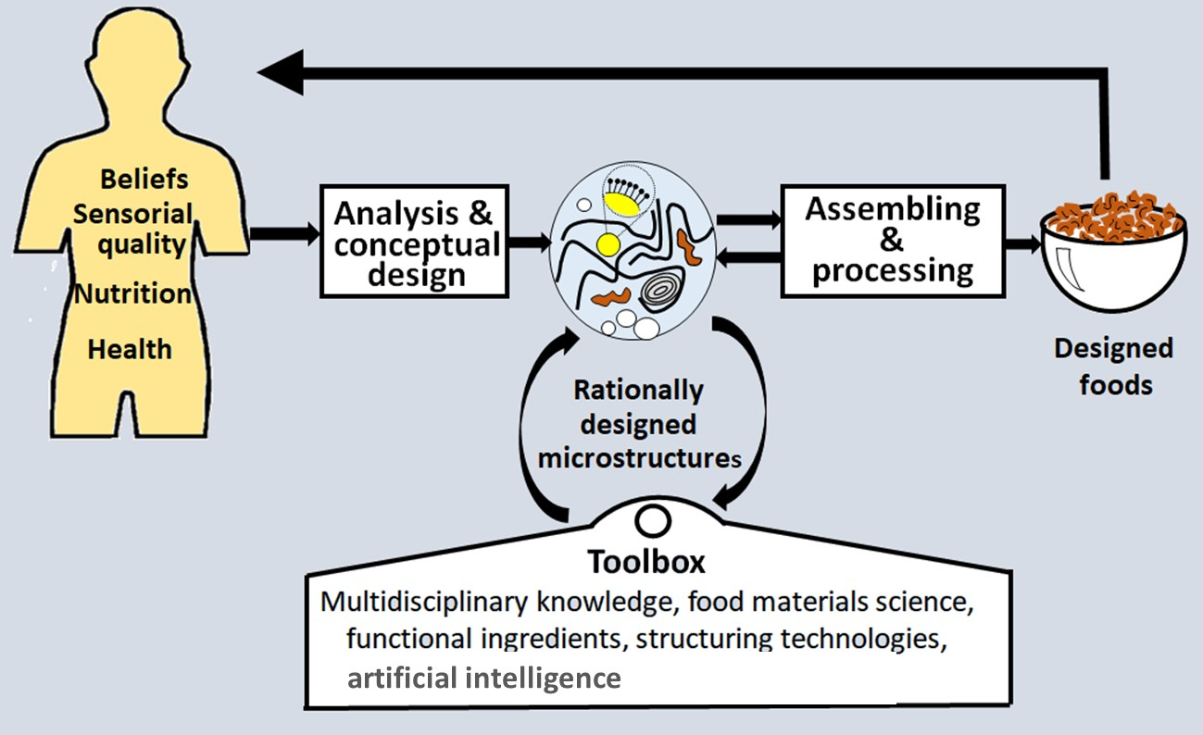
Rational design of food matrices (reverse engineering)
Matrix design
Novel technologies
Matrix
Aguilera, J.M. 2022. Rational food design and food microstructure, Trends Food Sci. Technol. 122:256-264

Slide 23
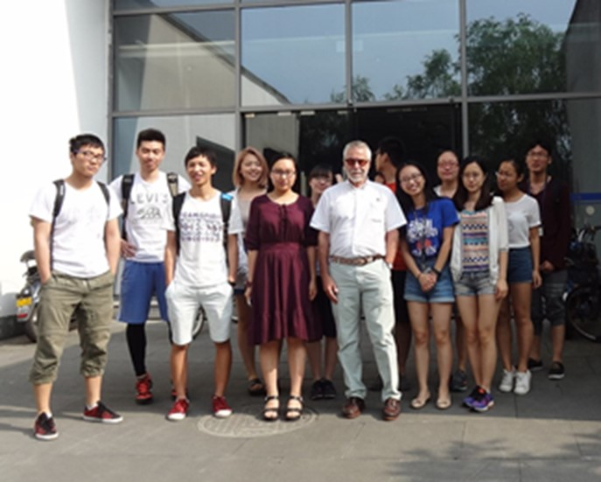
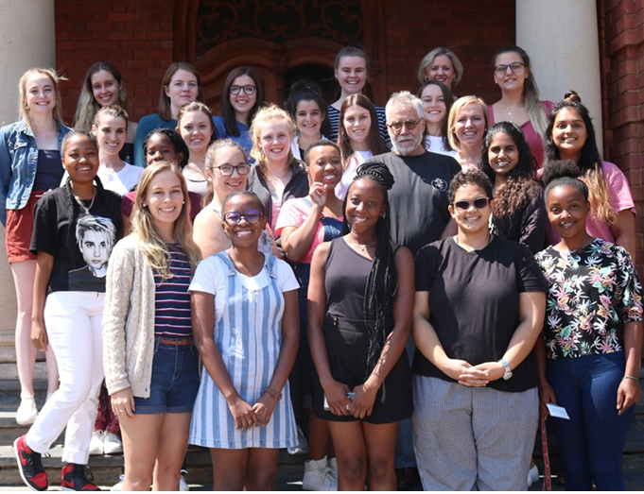

Our course on Gastronomic Engineering
Teaching science and engineering using cooking
Elective course open to undergraduate students
Flipped-classroom modality
Lecture notes (270 pp)
Demos from a chef
Hands-on experience for students
China
South Africa
Aguilera, J.M. & Moreno, M.C. 2021. Teaching engineering and food:
from traditional approaches to a flipped course on gastronomic
engineering. Food Engineering Reviews 13:916-928.

Slide 24
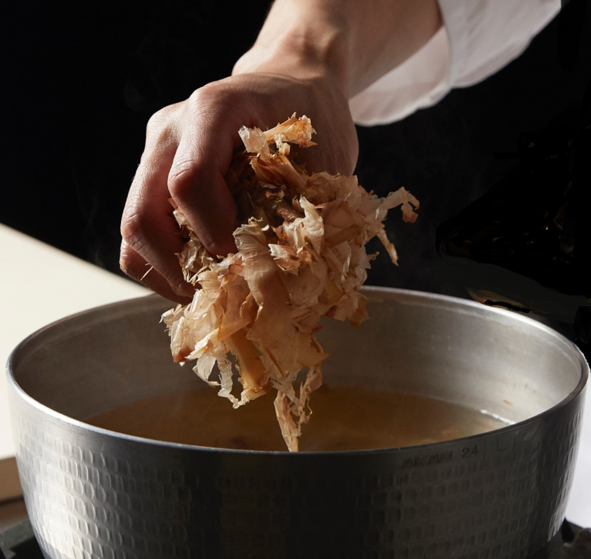
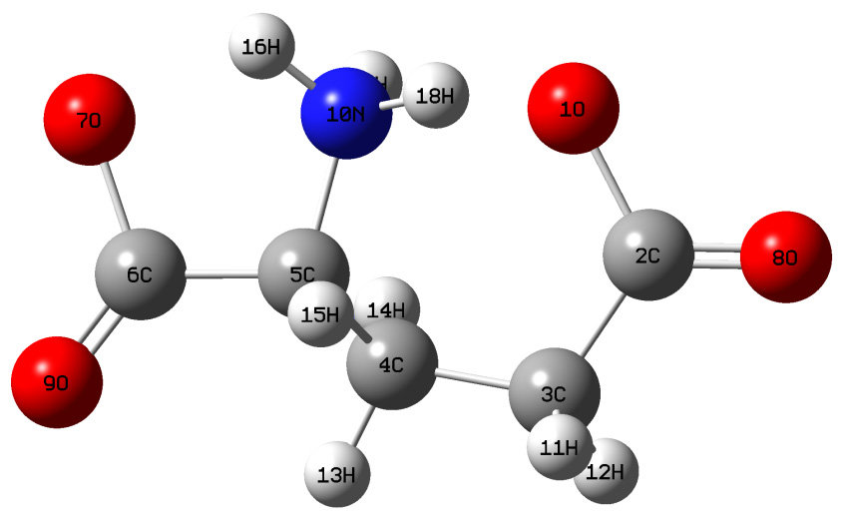
Dashi
Kombu seaweed broth
UMAMI
(savoury, delicious)
(うま味)
Glutamic acid

Slide 25
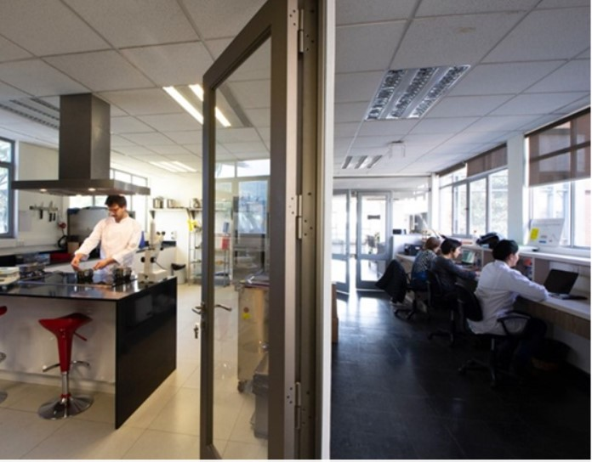
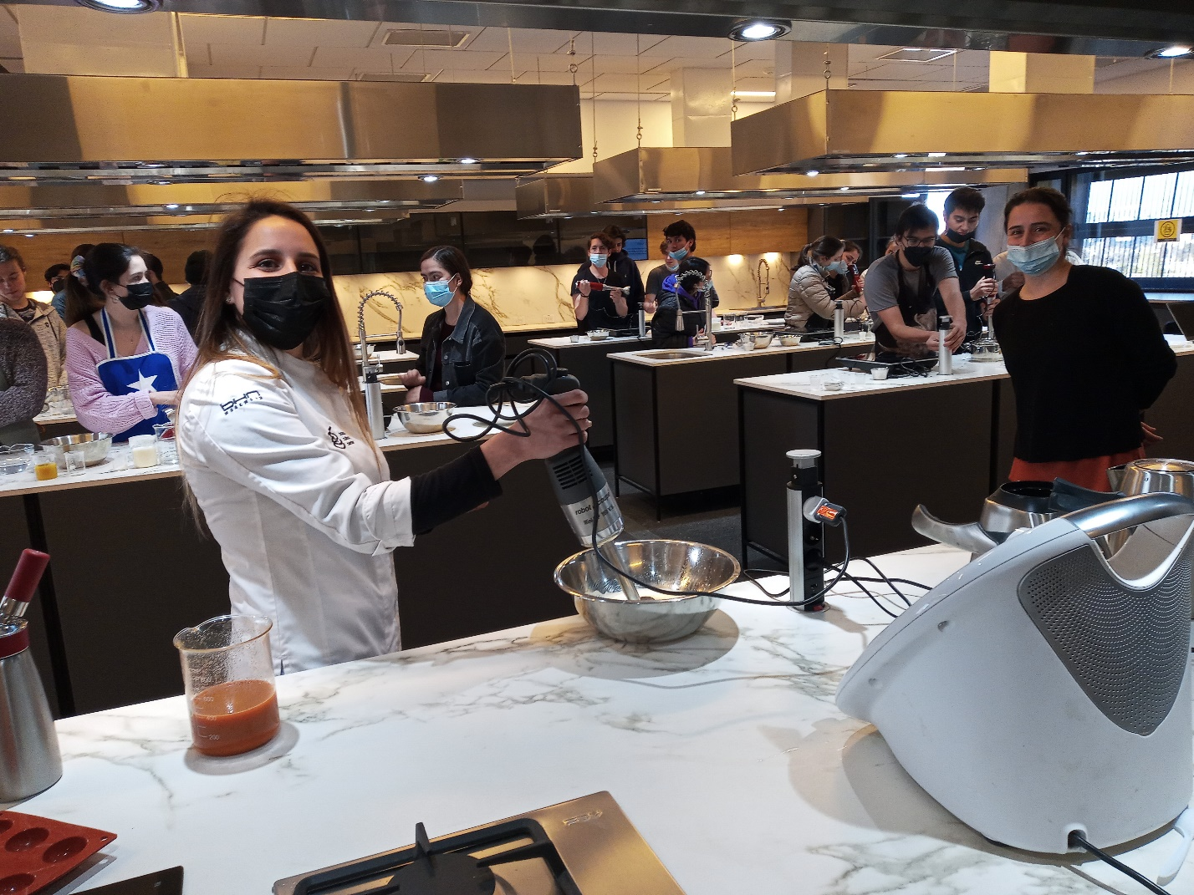
Experimental kitchen(2014) and lecture room (2020)

