Slide 1


NOTE BY NOTE COOKING
BHUMIKA PATEL
Erasmus Mundus FIPDes Cohort 9
30 November, 2020

Slide 2
TABLE OF CONTENTS
Introduction
Ingredients and recipe
  For the curry
  For the soyabean chunks
  For the alginate beads
  For the tandoori garlic naan bread
Final assembling
References

Slide 3
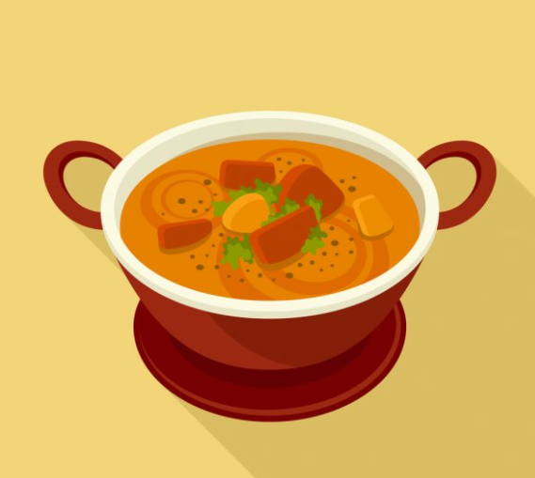
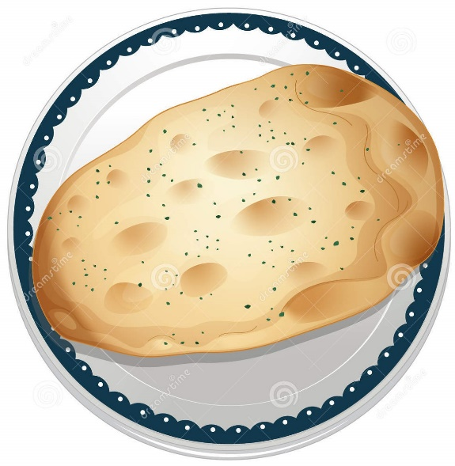
SOYA CHUNK CURRY WITH TANDOORI GARLIC NAAN
Soyabean chunks and spicy beads suspended in a flavourful curry paired with smoky, garlicy naan bread
Source: https://depositphotos.com/vector-images/curry.html
Source: https://www.dreamstime.com/illustration/naan-bread.html
Image 1, 2: Representative images of soya chunk curry with tandoori garlic naan

Slide 4
INGREDIENTS AND RECIPE

Slide 5
FOR THE CURRY
Ingredient | Quantity | Details
Starch | 20 grams | For the thick consistency of the curry
Water | 200 grams | For the liquid like consistency
Vegetable oil (mostly triglyceride) | 20 ml | For mouth feel
Dimethyl sulfoxide | 4 drops | For onion flavour
Isobutyraldehyde | 1 drop | For paprika flavour
Allyl isothiocyanate (garlic) | 2 drops | For garlic flavour
Butyraldehyde (ginger) | 2 drops | For ginger flavour
(−)-Bornyl acetate (coriander) | 2 drops | For coriander flavour
Acetaldehyde (cumin) | 2 drops | For cumin flavour
Acetoin (tomato) | 6 drops | For tomato flavour – sweet and tangy
Carotenoids (Amarouciaxanthin A or 9-cis-Antheraxanthin or β-Carotene) for orange colour | Few drops | For the orange colour of the curry
Curcumin | 10 mg | For turmeric flavour
Citric acid | 1 drop | For sour flavour
Salt | According to taste | To balance the taste of all the spices
Sucrose | According to taste | To balance the taste of all the spices

Slide 6
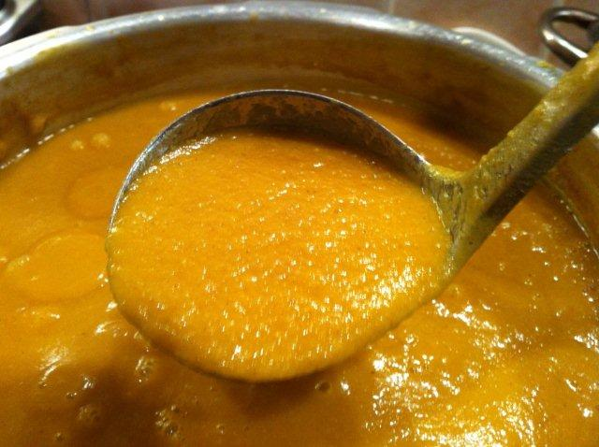
RECIPE
Take 20 grams of starch and add 200 grams water. Mix it well and heat it at 90°C.
Turn the heat to low.
Add 20 ml of vegetable oil, 4 drops of dimethyl sulfoxide, 1 drop of isobutyraldehyde, 2 drops of allyl isothiocyanate, 2 drops of butyraldehyde, 2 drops of (−)-Bornyl acetate, 2 drops of acetaldehyde, 6 drops of acetoin, 10 mg of curcumin, salt and sucrose, a drop of citric acid, add few drops of carotenoids to get an orange-brown colour.
Mix everything till you get a thick gravy like consistency of the curry.
Source: https://www.curry-recipes.co.uk/curry/index.php?topic=11354.0
Image 3: Representative image of the curry

Slide 7
FOR THE SOYABEAN CHUCKS:
Ingredient | Quantity | Details
Soy protein isolate | 50 grams | To make the body of the soyabean chuck
Water | 50 grams | To mix all the ingredients
Citric acid | 0.4 grams | It reduces the pH and helps to create coarse protein structure on gelation
Vegetable oil (triglyceride) | 100 ml | To fry the final product
Allura Red | 1 drop | Red and brown mix to give brown colour, replicating the soyabean chunks
Brilliant Black BN | 1 drop
Salt | According to taste | Light salty-sweet taste
Sucrose | According to taste
Starch | 10 grams | For texture

Slide 8
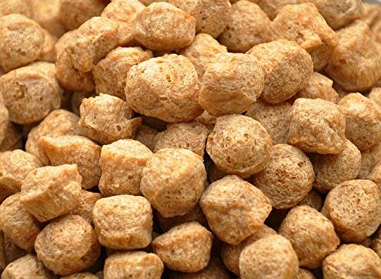
RECIPE
Mix 50 grams of soy protein in 50 grams of water, mix it well to get a smooth and thick paste.
Add some salt and 0.4 grams of citric acid.
Add one drop each of Allura red and brilliant Black BN to get a brown colour.
Cook the mixture at 90°C in a water bath for 30 minutes.
Once a gel is obtained place this in a fridge at 4°C for at least 2 hours.
Once set, cut small cylinders from this gel and roll it on the mixture of salt, sucrose and starch.
In a pan add 100 ml of oil and fry these cylinders to get a fluffy product with a crispy surface.
Source: https://www.amazon.in/TejasCare-Soya-Chunks-Meal-Maker/dp/B07DB7GB91
Image 4: Representative images of soya chunk

Slide 9
FOR THE ALGINATE BEADS:
Ingredient | Quantity | Details
Sodium alginate | 1 gram | For small beads
Water | 100 grams | To dissolve the alginate
Vegetable oil | 50 ml | To convert the solution into beads
Salt | According to taste | For taste
(−)-Bornyl acetate | 1 drop | For a fresh coriander flavour
Isobutyraldehyde | 1 drop | For spicy paprika flavour
Limonene | 1 drop | For fresh lemony flavour
Leucomalachite Green | 1 drop | For green colour

Slide 10
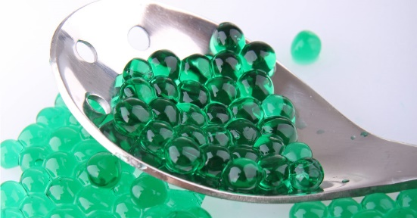
RECIPE
Add 1 gram of sodium alginate to 100 grams of water, mix thoroughly.
Heat this mixture and bring it to a boil, till the alginate is completely dissolved.
Add 1 drop of (−)-Bornyl acetate, 1 drop of isobutyraldehyde, 1 drop of limonene and half a teaspoon of salt, then add 1 drop of Leucomalachite Green for colour and mix well.
Take cold vegetable oil in a glass and using a syringe put drop by drop the mixture prepared into the cold oil.
Small circular beads will form in the oil, take them out of the oil and place it on an absorbent paper to remove oil from its surface.
These flavorful alginate beads are added to the curry to give it a heterogenous texture. Thus, it will more closely resemble the mouth feel of the curry. Even these alginate beads will be suspended in the curry.
Source: https://blog.modernistpantry.com/advice/agar-or-alginate-spherification-whats-the-difference/
Image 5: Representative images of alginate spheres

Slide 11
FOR THE TANDOORI GARLIC NAAN BREAD:
Ingredient | Quantity | Details
Pea protein | 50 grams | For texture and mass of the final product
Gluten flour | 50 grams | For the chewy texture
Starch | 50 grams | To provide mass to the final product
Water | 100-150 grams | Aid in mixing all the ingredients
Vegetable oil | 5 ml | For mouth feel
Salt | 2 grams | For taste
Allyl isothiocyanate | 2 drops | For the garlicy flavour
Butter Yellow-(phenyl-d5) | 1 drop | For a pale yellow colour
Charcoal | 2-3 small pieces | For the smoky/tandoori flavour

Slide 12
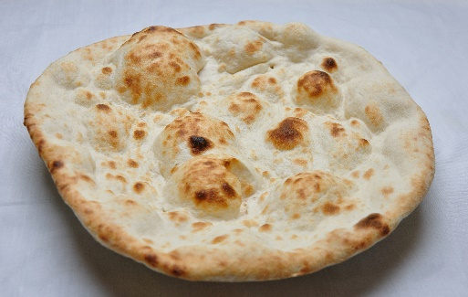
RECIPE
Mix 50 grams of pea protein powder, 50 grams of gluten flour, 50 grams of starch, add 2 grams of salt, 2 drops of allyl isothiocyanate and 1 drop of Butter Yellow-(phenyl-d5) along with 100-150 grams of water to get a dough.
Add 5 ml of vegetable oil to make it non-sticky. Make small balls from this dough and spread them in the shape of an oval with your fingers to get a sheet.
In a heated non-stick pan, place this oval-shaped sheet, cook from both sides to get a firm and chewy bread like mass.
Once, these naan bread are ready, take a metal bowl with a piece of hot charcoal and add few drops of oil of it to produce smoke, place this bowl on the naan bread and cover the plate with a big lid to all the bread to absorb the smoky, tandoori flavour.
Take a culinary blow torch and create blackened patches to create visual effect.
Source: http://tks.ae/product/tandoori-naan-2/
Image 6: Representative images of naan bread

Slide 13
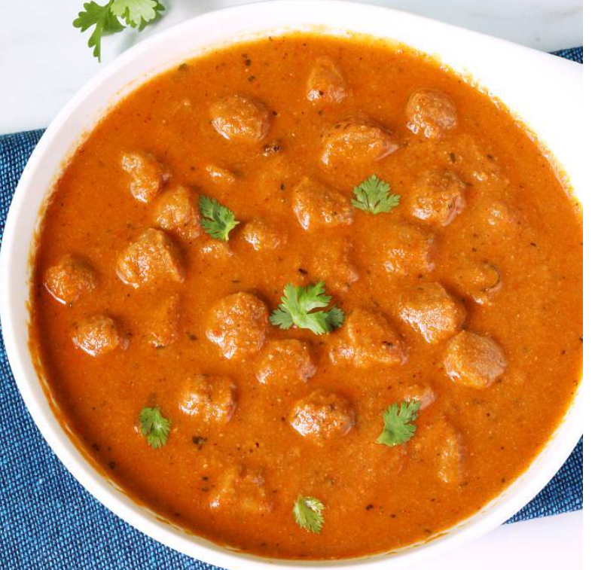

FINAL ASSEMBLING
Add the soya chunks and alginate beads to the warm curry and give it a mix for these ingredients to suspend in the curry, it is served hot along with warm tandoori garlic naan.
Source: https://www.indianhealthyrecipes.com/soya-chunks-curry-meal-maker-curry/ Source: http://tks.ae/product/tandoori-naan-2/
Image 7, 8: Representative images of Soya chunk curry with tandoori garlic naan

Slide 14
REFERENCES
Hervé, T. (2018). The Future of Food is Note by Note Cooking. [online] MAD Feed. Available at: https://www.madfeed.co/2015/mad-dispatches-the-future-of-food-is-note-by-note-cooking/ [Accessed 24 Nov. 2020]
Paris, G. (2018). International Contest for Note by Note Cooking N°7 - AgroParisTech. [online] http://www2.agroparistech.fr/The-announcement-of-the-International-Contest-for-Note-by-Note-Cooking-No7 [Accessed 24 Nov. 2020].
Paris, G. (2018). International Contest for Note by Note Cooking N°5 - AgroParisTech. [online] http://www2.agroparistech.fr/Fibrous-consistencies-and-acidities.html [Accessed 24 Nov. 2020].
Food & Beverage Standards, Merck, https://www.sigmaaldrich.com/analytical-chromatography/analytical-products.html?TablePage=9641147
Iqemusu (2017). The 24 Notes. [online]. Available at: https://iqemusu.com/en/the-24-notes-note-by-note-cooking/
Louis François (2019). Louis François- Food Ingredients Since 1908. Available at: http://www.louisfrancois.com/index_en.html
MSK (2019), MSK catalogue. [online] Available at: http://msk-ingredients.com/msk-catalogue-2019/?page=1.
Sosa (2019). Sosa Catalogue. Available at: https://www.sosa.cat/ Texturas (2012)
Texturas Albert y Ferran Adria. Available at: http://albertyferranadria.com/eng/texturas.html

Slide 15
THANK YOU

