Slide 1
Granada cheesecake
Rosa María Martínez Hernández
Ignazio Zaragoza 27-A colonia Apatlaco
Telefono: 5543845224
S
Samantha Sandoval Bautista
Virgilio Uribe 95
Telefono: 5522970123

Slide 2
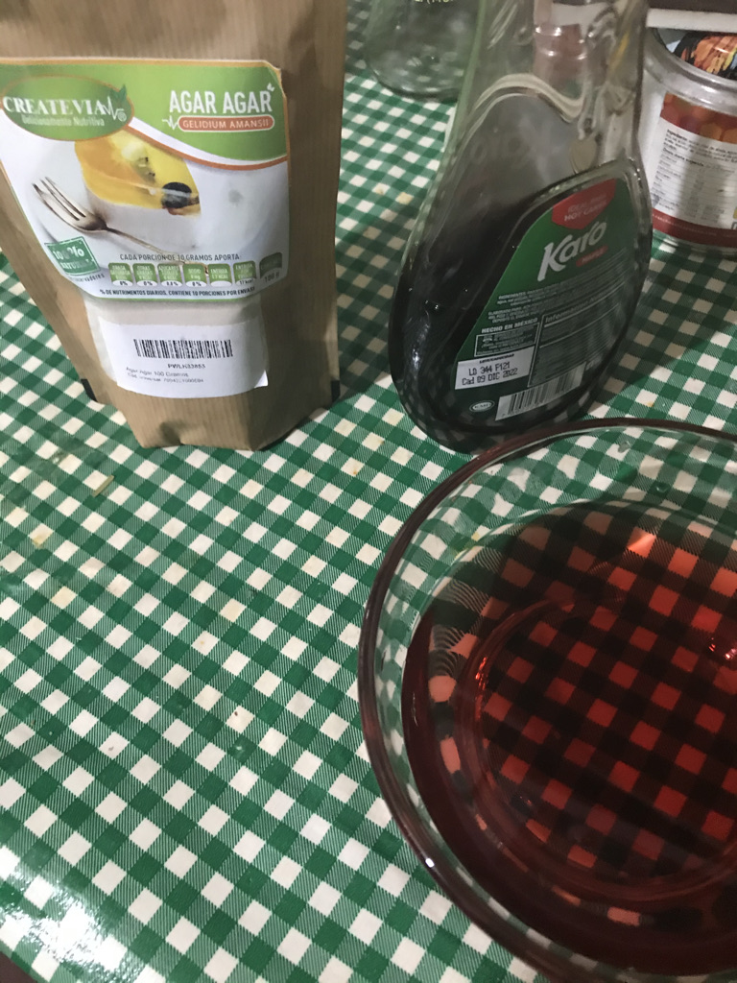
Having weighed the ingridients

Slide 3
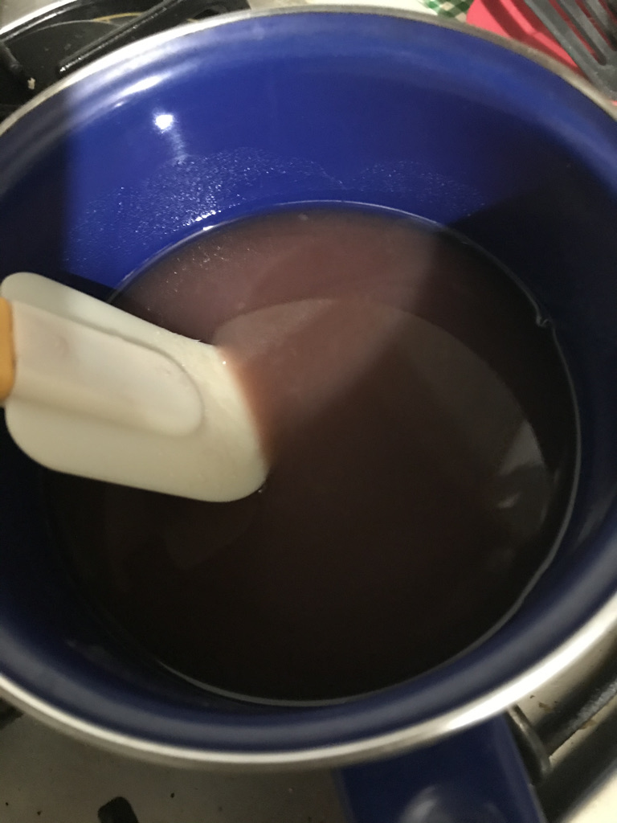
To hydrate the grenetina in hot: in a pudding bowl with water add little by little the agar agar in water

Slide 4
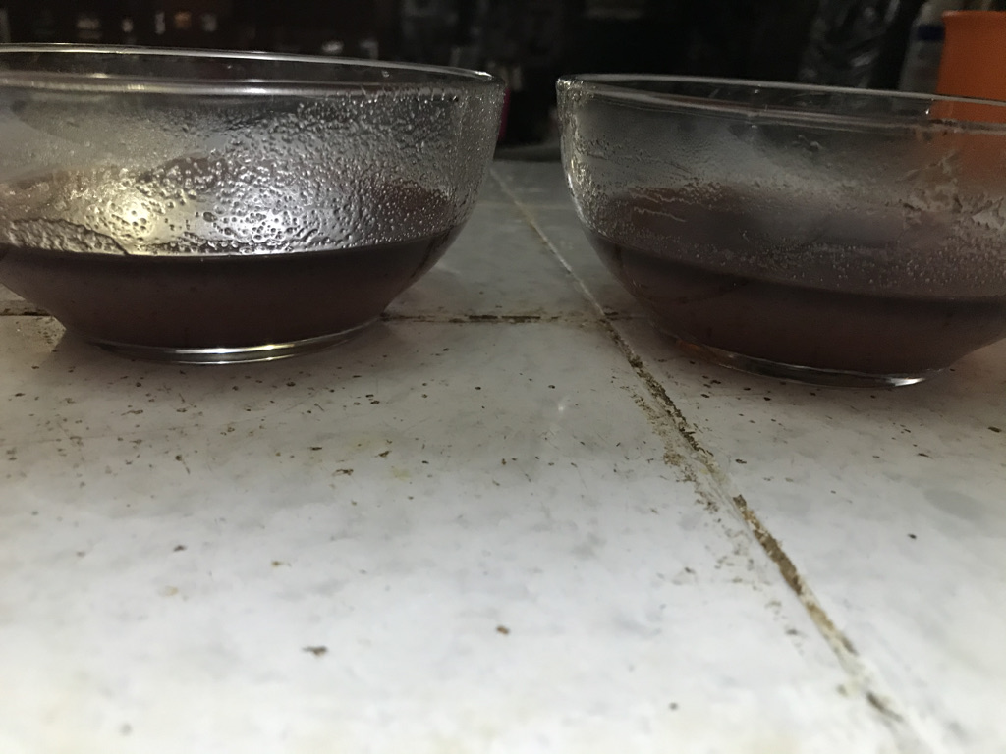
Pour the mixture into the silicone molds.

Slide 5
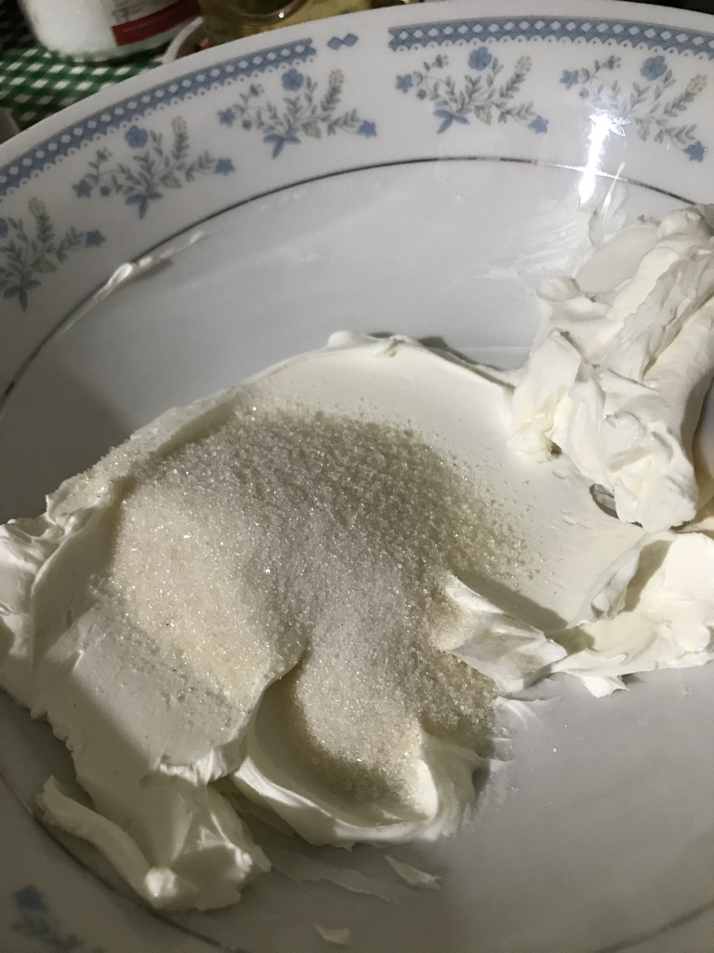
Cream the cream cheese with the sugar.

Slide 6
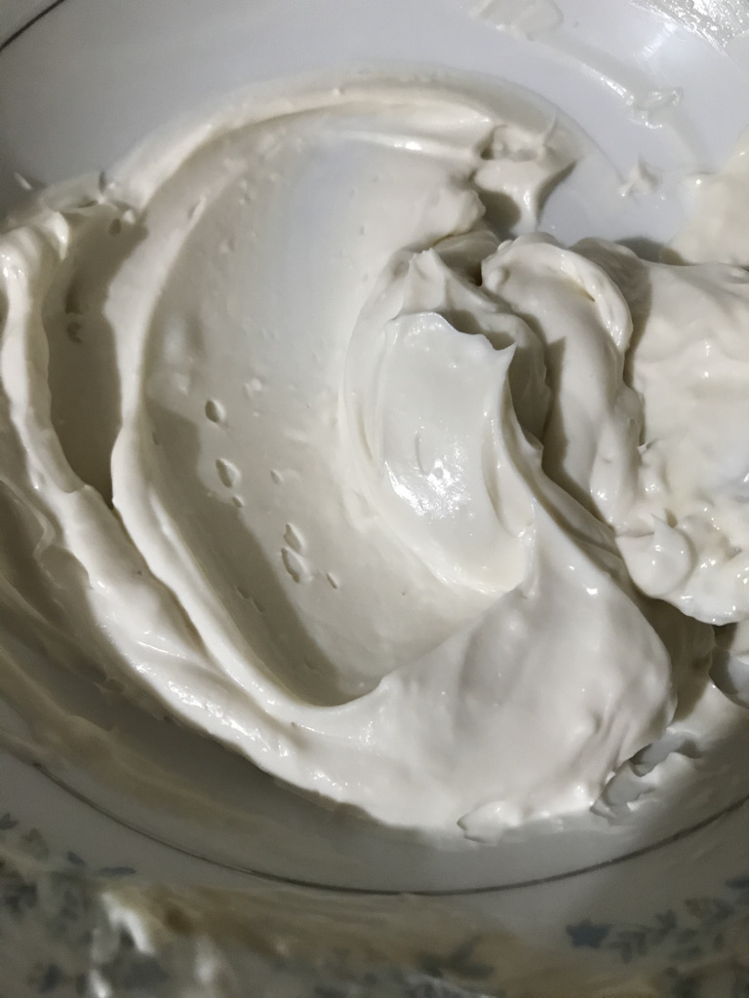
Once ready, add the yogurt, vanilla extract and lemon juice; mix until all the ingredients are incorporated.

Slide 7
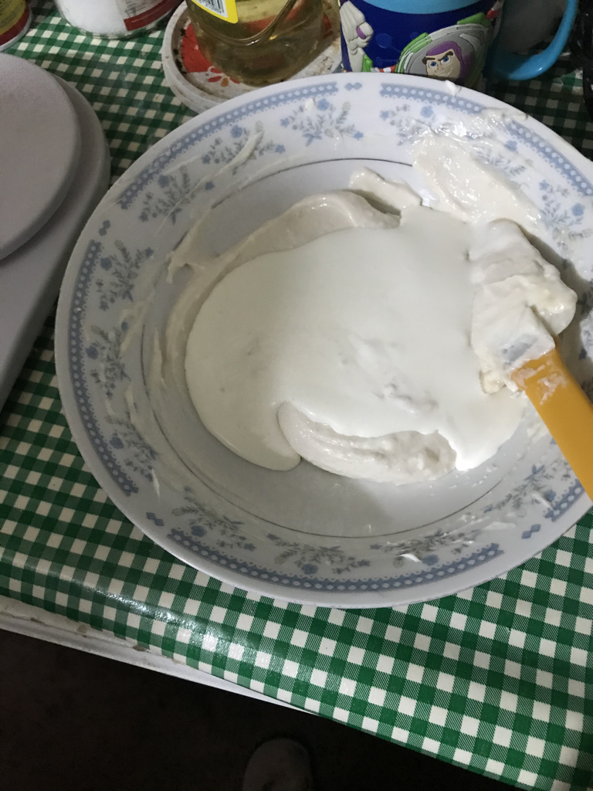
Add the lyncott cream.

Slide 8
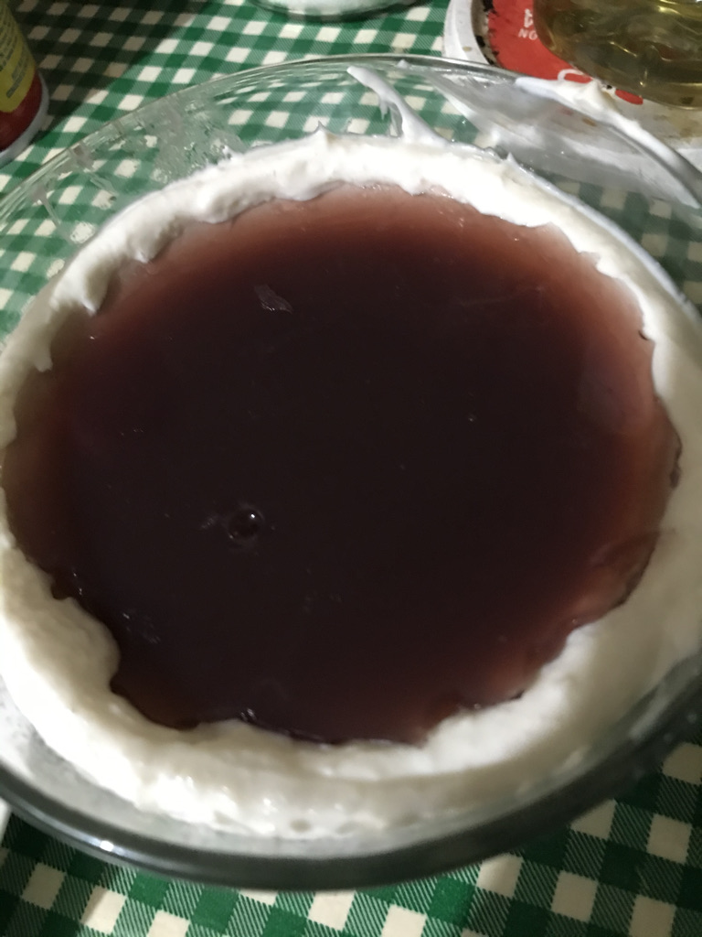
Put half of the preparation in the circular mold in each space, then put the rubber band, avoiding the liquid to overflow.

Slide 9
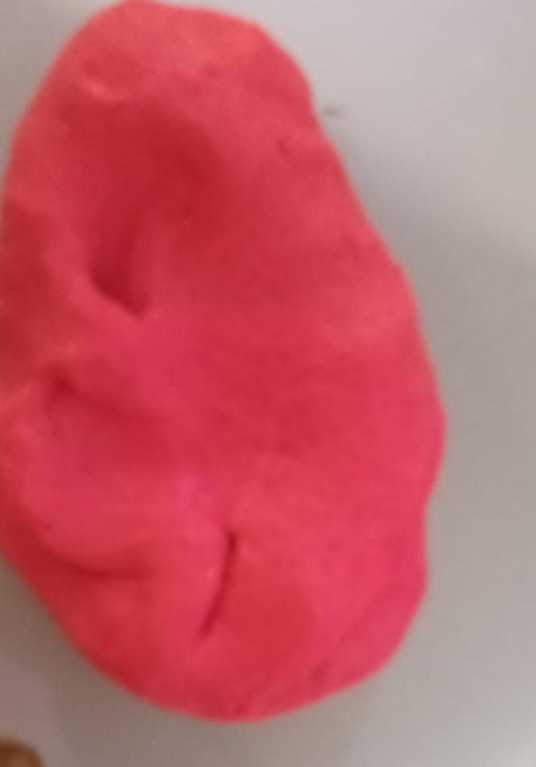
Stop in two and add coloring. (the first one will be white and the second one red)

Slide 10
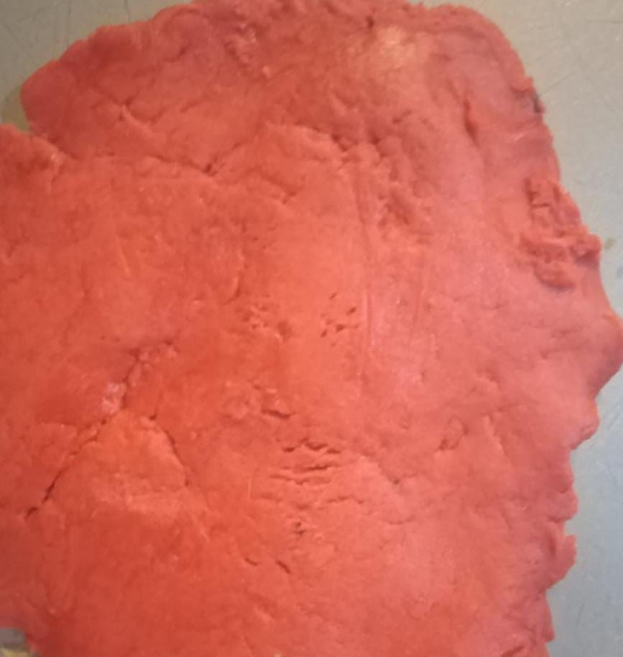
Cover them with the white fondant and remove the residue

Slide 11
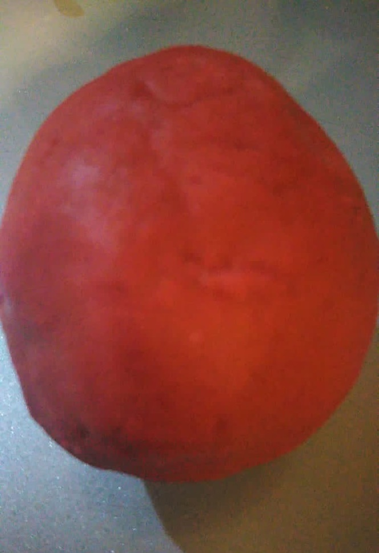
Once well covered, put the red fondant and remove the residue in the same way.

