Slide 1
NOTE BY NOTE COOKING PROPOSAL
REINVENTION OF THE BRAZILIAN VERSION OF STROGANOFF
LUCAS JOAO MEZZOMO
PARIS, FRANCE
NOVEMBER 2020.

Slide 2
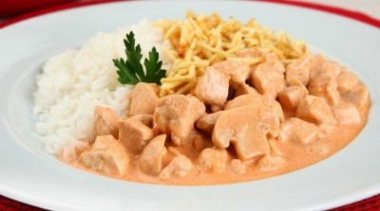
JUSTIFICATION
Idea of reinventing the Brazilian version of Stroganoff:
Stroganoff can be considered a suspension (meat in sauce) → Topic of the 9th International Note by Note (NbN) Cooking Contest.
Made with chicken breast and sauce (containing onion, tomatoes/ketchup, mustard, and champignons).
Part of the whole dish to be reinvented in this NbN proposal
Approach: combination of two preparations
1) Meat-flavoured alginate beads and
2) NbN Sauce.
Figure 1 – Typical Brazilian version of Stroganoff eaten with rice and shoestring potatoes.
Source: Brazilian Times (2017)

Slide 3
RECIPE
MEAT-FLAVOURED ALGINATE BEADS
Ingredient | Quantity | Details
Water | 200mL | -
Sodium alginate | 1g | For making the alginate pearls
Calcium lactate | 1g | For making the alginate pearls
2-methyl-3-furanthiol | 3 drops | Cooked chicken flavour
2-furfurylthiol | 2 drops | Cooked chicken flavour
γ-dodecalactone | 1 drop | Cooked chicken flavour
Beta carotene | 1 drop | Provides a light yellow colour to the solution

Slide 4
RECIPE
Note by Note Sauce
Ingredient | Quantity | Details
Water | 125mL | Basis of the sauce
Corn starch | 5g | Thickening agent
Vinegar | 3mL | Acidic flavour usually coming from ketchup
NaCl | 500mg | Savory flavour
Lycopene | 20mg | Provides a light red colour to the sauce (usually coming from the tomato sauce in the original recipe)
oct-1-en-3-ol | 3 drops | Mushroom-like flavour
cis‐3‐hexenal | 3 drop | Tomato-like flavour
2-3-butanedione | 2 drops | Butter-like flavour
Allyl isothiocyanate | 1 drop | Mustard-like flavour
2-methoxy-3-isobutylpyrazine | 1 drop | Bell pepper-like flavour
methyl propyl disulfide | 1 drop | Onion/garlic-like flavour

Slide 5
EQUIPMENT
Equipment | Quantity
Bowl | 4
Blender (normal or handheld immersion) | 1
3-cm diameter round measuring spoon | 1
Strainer | 1
Spoon | 3
Cooking pot | 1
Stove/Inducing hob | 1

Slide 6
PROCEDURE
MEAT-FLAVOURED ALGINATE BEADS
1) Add into 100mL of water, the drops of 2-methyl-3-furanthiol, 2-furfurythiol, gama-dodecalactone and beta carotene, then mix it for 30 seconds with either a normal or a handheld immersion blender;
2) Incorporate the sodium alginate, mixing again the solution thoroughly for 3 minutes. Leave the mixture to settle for, at least, 15 minutes to remove bubbles;
3) In Parallel, prepare the calcium solution by adding 1g of calcium lactate into 100mL of water. Mix well until the calcium lactate is completely dissolved;
4) Using a 3cm-diameter round measuring spoon, scoop out the sodium alginate-pure-compound solution, adding it carefully into the calcium lactate solution. Once the alginate spheres (beads) are formed, allow them to settle for 30 seconds and then strain;
5) Rinse the alginate beads twice to remove excess of calcium.

Slide 7
PROCEDURE
NOTE BY NOTE SAUCE
1) Add into 75mL of water, the sodium chloride, lycopene, oct-1-en-3-ol, cis‐3‐hexenal, 2-3-butanedione, allyl isothiocyanate, 2-methoxy-3-isobutylpyrazine, and methyl propyl disulfide, bringing it to simmer;
2) Dissolve the corn starch in 50mililiters of water (at 25°C) and add it to the previous mixture.
3) Then, incorporate 3 millilitres of vinegar and mix to obtain the sauce.

Slide 8
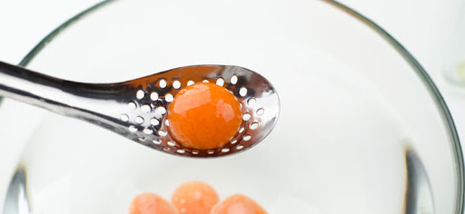
PRESENTATION OF THE DISH
Figure 2a – Intended Strogonoff sauce
Source: adapted from Richa (2019)
Pour the sauce at 40°C inside a soup bowl and add the alginate beads at the top of it. Figure 2a shows the presentation of the sauce in a bowl. Figure 2b shows an idealistic approximation of the meat-flavoured alginate beads.
Figure 2b – Intended form and size of the meat-flavoured alginate beads
Source: Quantum Chefe (2014)

Slide 9
REFERENCES
Brazilian Times (2017). Strogonoff solidário vai ajudar família de brasileiro com câncer. [online] Brazilian Times. Available at: https://www.braziliantimes.com/comunidade-brasileira/2017/08/23/strogonoff-solidario-vai-ajudar-familia-de-brasileiro-com-cancer.html [Accessed 25 Nov. 2020].
Quantum Chef (2014). Carrot, Orange & Mango Spheres with Rose Crystals. [online] Molecular Recipes. Available at: http://www.molecularrecipes.com/spherification-1/carrot-orange-mango-spheres-rose-crystals/ [Accessed 24 Nov. 2020].
Richa (2019). Vegan Mushroom Sauce - No Oil Option - Vegan Richa. [online] Vegan Richa. Available at: https://www.veganricha.com/vegan-mushroom-sauce/ [Accessed 24 Nov. 2020].

