Slide 1



International Contest
for
Note by Note Cooking
Topic: Suspensions
Recipe Name: Ice-Cream Balls
Submitted By-
Gautam KOHLI (gautamkohli663@gmail.com)
FIPDES

Slide 2
Description
Ice-cream is a foam, emulsion and a suspension, making it a highly complex system (Walstra et. al., 2005). The final product contains, soft caramel balls and caramel crackers suspended in vanilla ice cream, to create a multitextured sensation while consumption.
Once the ice cream is made it is coated with chocolate flavour, chocolate colour and sodium alginate mix to create a second layer outside the ice cream balls. The recipe is inspired from ice-cream sundae’s I like a lot.

Slide 3
Ingredients
Sodium Alginate Slurry
Sodium Alginate | 5g
Water | 1000g
Vanilla Ice Cream
Water | 275g
Calcium Caseinate | 1000g
Clarified Butter | 82.5g
Sucrose | 115g
Vanilla Powder | 7.5g
Chocolate Covering
Sodium Alginate | 5g
Water | 980g
Chocolate Colour | 15g
Cocoa Butter | 150g
Vanilla Flavour | 0.5g
Chocolate Flavour | 5g
Liquid Caramel
Powdered Caramel | 2.5g
Water | 25g
Calcium Lactate | 0.75g
Caramel Crackers
Sucrose | 100g

Slide 4
Process
SOFT CARAMEL BALLS
Powdered Caramel, Calcium Lactate and water are mixed
Using a dropper the mixture poured into sodium alginate slurry
Soft Caramel Balls are washed in water.
CARAMEL CRACKERS
The sugar is heated in the pan at high temperature.
Heating is stopped when dark brown colour is seen.
The hardened mass is broken into small crackers.
VANILLA ICE_CREAM (Bylund, 2003)
Calcium Caseinate, vanilla powder, sucrose and clarified butter is dissolved in water.
Using the kitchen scale ice-cream maker the freezing is started followed by hardening.
At 4 ^{ᵒ}C, the soft caramel balls (25g) and caramel crackers (25g) is added into the mix.
Final Assimilation
CHOCOLATE COVERING
The water is heated to 60 ᵒC, and chocolate colour, flavour, cocoa butter, vanilla flavour is dissolved.
The mixture is then poured into a blender with sodium alginate to create the covering, which is then rested for 1 h.

Slide 5
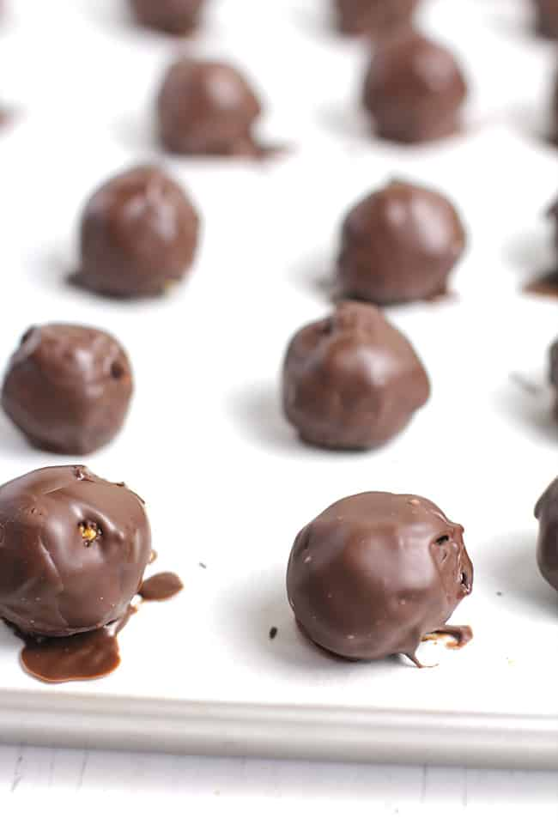
Picture
CROSS-SECTION VIEW
SOFT CARAMEL
CHOCOLATE COVERING
VANILLA ICE-CREAM
CARAMEL CRACKERS
(SueBee Homemaker)

Slide 6
References
1. SueBee Homemaker. Dark Chocolate Covered Energy Bites. Available from: https://suebeehomemaker.com/dark-chocolate-covered-energy-bites/#comments, [Accessed on 23 November 2020].
2. Bylund, G., 2003. Dairy processing handbook. Tetra Pak Processing Systems AB.
3. Walstra, P., Walstra, P., Wouters, J.T. and Geurts, T.J., 2005. Dairy science and technology. CRC press.

