Slide 1
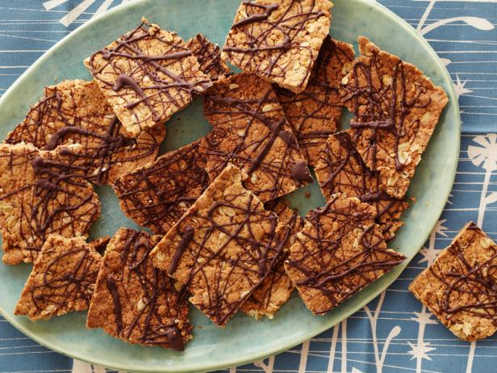
« But the crackling is superb »
NOTE BY NOTE DISH Proposal
Tomaž Verdinek
http://food.fnr.sndimg.com/content/dam/images/food/fullset/2012/10/26/0/FNK_Healthy-Crunchy-Peanut-Butter-Thins_s4x3.jpg.rend.hgtvcom.616.462.suffix/1382541939773.jpeg

Slide 2
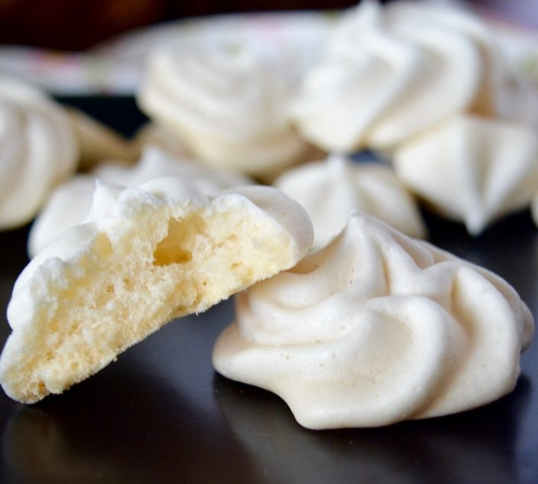
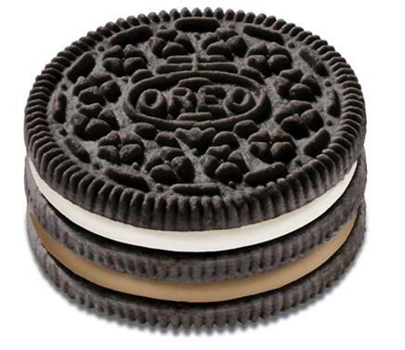
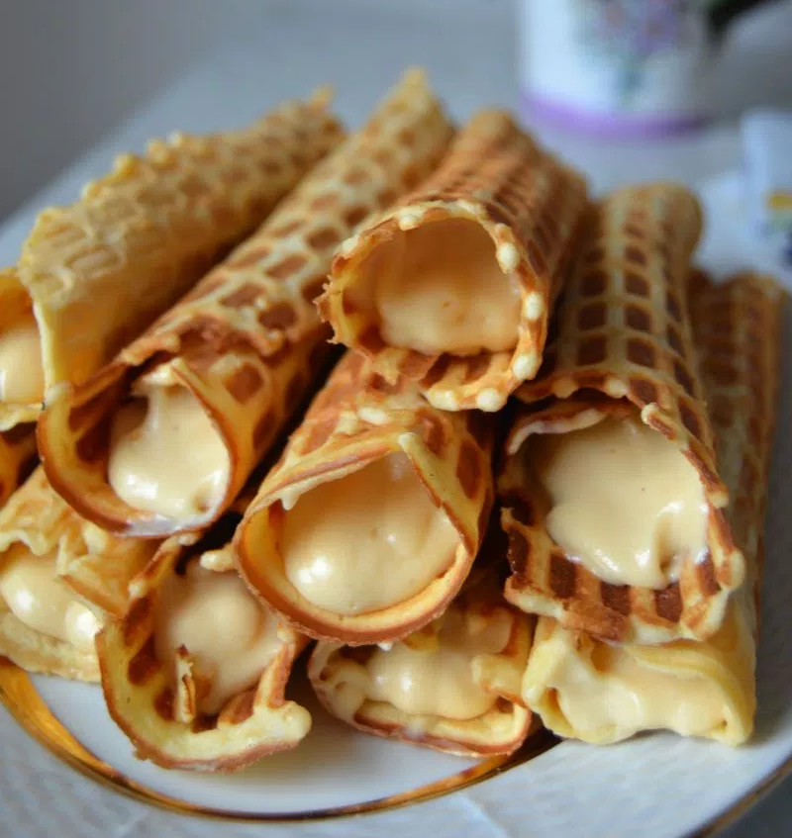
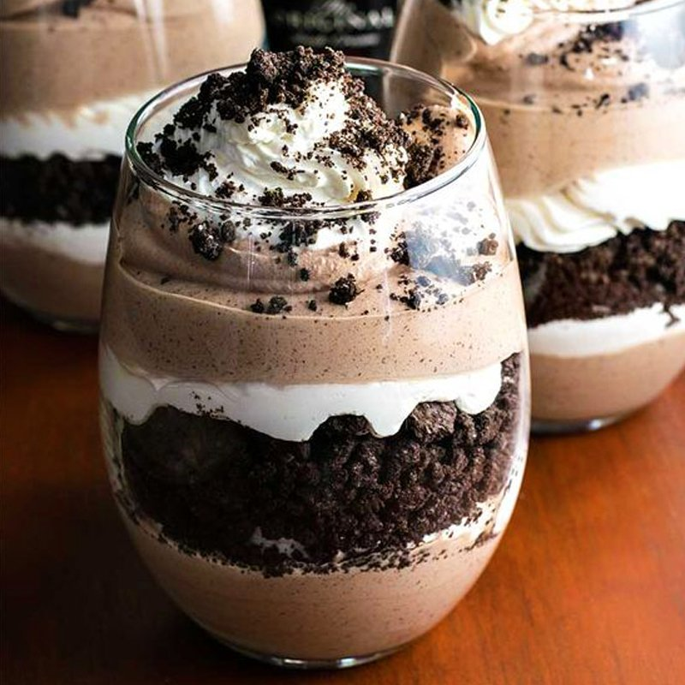
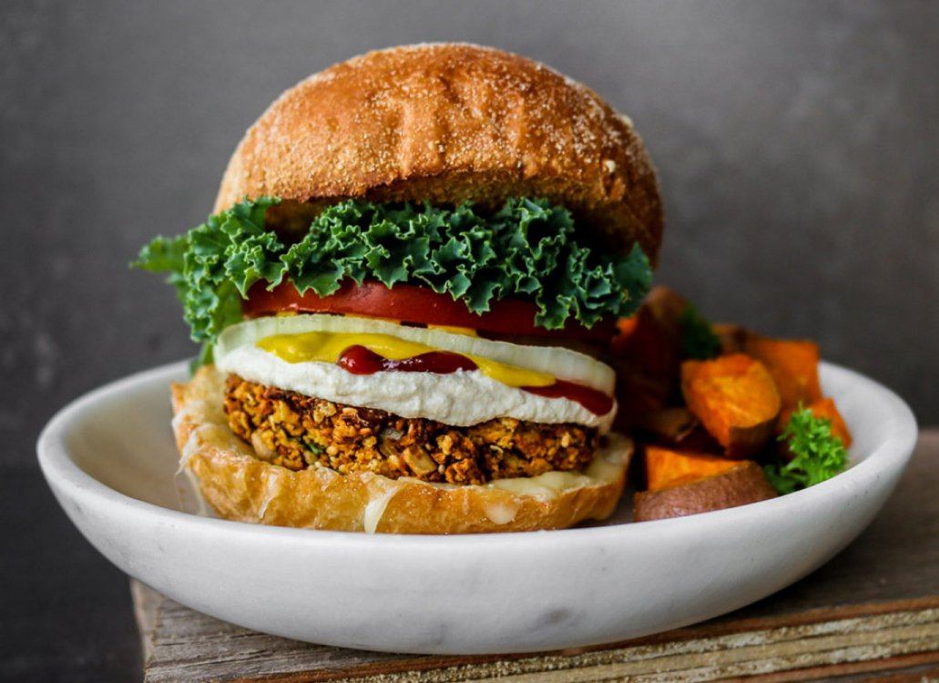
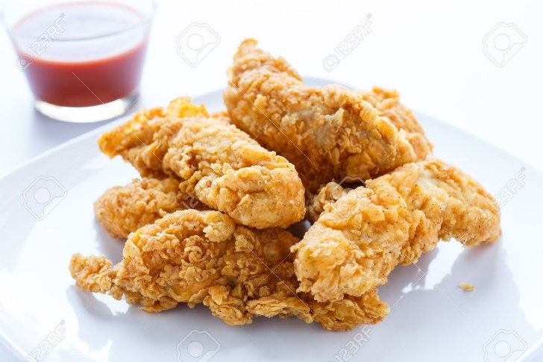
The foods that are crackling
Consist of different crackling parts
Consist of crunchy particles dispersed in a medium
You can hold the food in your hand or
Simply eat with a spoon
Notes:
Crispy Lithuanian Waffles with Dulce de Leche Cream Filling: https://www.meyerfoodblog.com/2017/01/24/crispy-lithuanian-waffles-dulce-de-leche-cream/
Crispy burger (?): http://www.onegreenplanet.org/vegan-recipe/crispy-chickpea-burger/

Slide 3
Story of Blue magic
Early morning on the seaside, it is almost 6 o´clock . I am on the coast of the Adriatic sea and I am walking on the beach.
I hear birds, sun is coming up and shines on the surface of the sea, the sea is clear like a glass… I see the fishermans in a distance that are coming back from fishing.
I will take a swim; I am walking down to the sea, steping on the stones and some shells are crackling under my feet
The further I go into the water, the sharper the stones are, but when I am finally able to swim, I melt in the smoothness of the sea and beautifulness of the morning

Slide 4
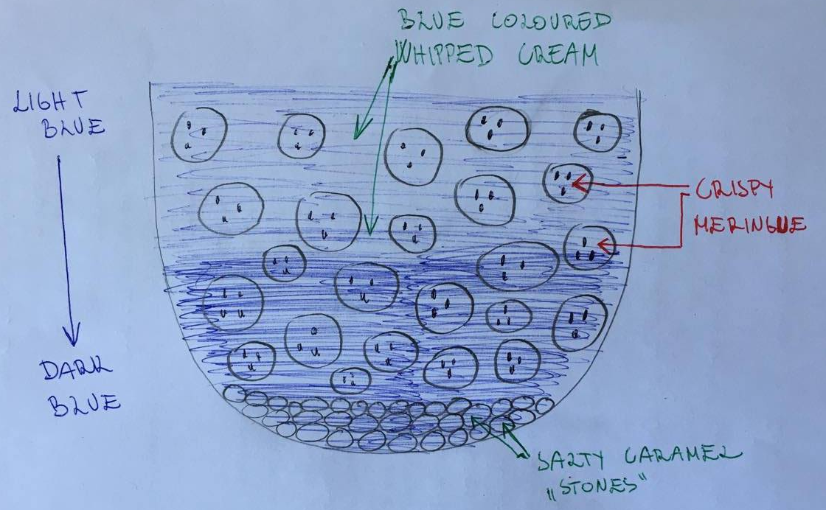
Blue magic
DISH:
Bottom of salty caramels
Crispy meringues with menthe pieces inside, covered in coconut butter with cictri acid note
All captured inside the „Blue Ocean“ made of whipped cream
The dish is also „layered“ with flavours:
-From top to bottom, there are layers of flavours – from „warm“ to „cold“ in the bottom

Slide 5
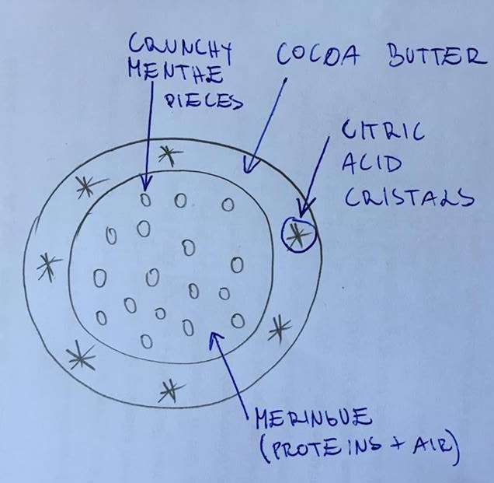
Blue magic
Crispy meringue
Crispy Menthe pieces:
→ Menthe + Proteins + Sugar; Use Menthe aroma / dissolve Menthe tea in water and add proteins (+sugar?). Dilute and pour over a baking sheet. Dry it in oven until crackling. Crush the menthe sheet into small pieces.
b) Meringue:
Egg white powder + water + sugar:
Whip/Mix egg white powder and water until soft foam; Gradually add sugar until the sugar disolves. Keep mixing until more form foam is structured. Stir in Menthe peaces, mix gently. Shape themeringues into small (1-1,5 cm diameter) balls and bake at 120°C until crusty.
c) Coconut butter cover with citric acid cristals
→ After meringues are baked and cooled down, melt the coconot butter and add very little citric acid and pinch of sugar; dip meringues in the butter and cool them down
SALTY CARAMEL STONES
Sugar + salt
Caramelize the sugar + add pinch of salt; cool down until it gets glassy, break into small pieces and add in the bottom of the glass

Slide 6
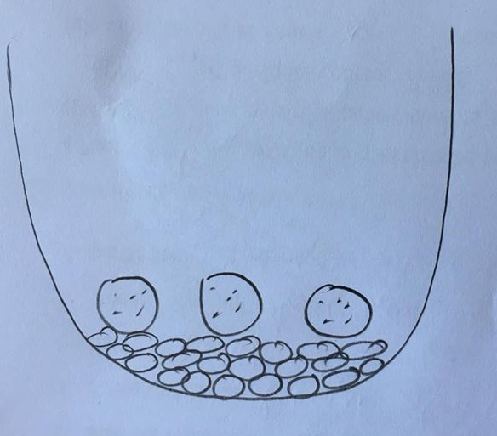
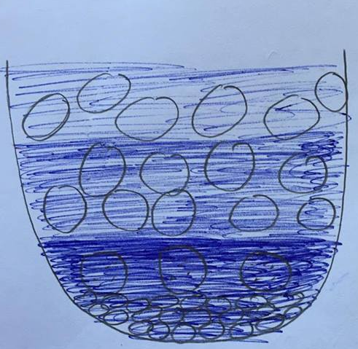
Blue magic
Blue Whipped cream
35 % fat
15 % sugar
10 % protein
40 % water
Blue colorant Brilliant blue FCF (C₃₇H₃₄N₂Na₂O₉S₃)
Divide the total recipe in 3 steps, you will make 3 layers of different blue shade
For the bottom part use the highest proportion of Brilliant blue, and for the top part the lowest amount.
Put the first layer on top of salty caramel „stones“ and few pieces of meringue; than put few more pieces of meringue and add the second layer of cream with lighter blue shade. Repeat once again with adding final pieces of Meringue and the last layer of the lightest blue colored cream
Adding layers of the ingredients

Slide 7
Blue magic
DSF Formula
Salty caramel pieces = { D0(Salt)+D2(Sugar) }
Crispy Menthe pieces = { D0 (Menthe) / (D1(Proteins)+D1(Sugar)) } (=S1)
Coconut butter with citric acid = { D0 (Citric acid) / D3 (Coconut butter) } (=S3)
Meringue = {D0(G)/ (D2(S1)@D2(S2)) } / D3(S3) }
Blue whipped cream = { D0(Fat, Sugar, Protein) / D3(L) }

